Slide 1
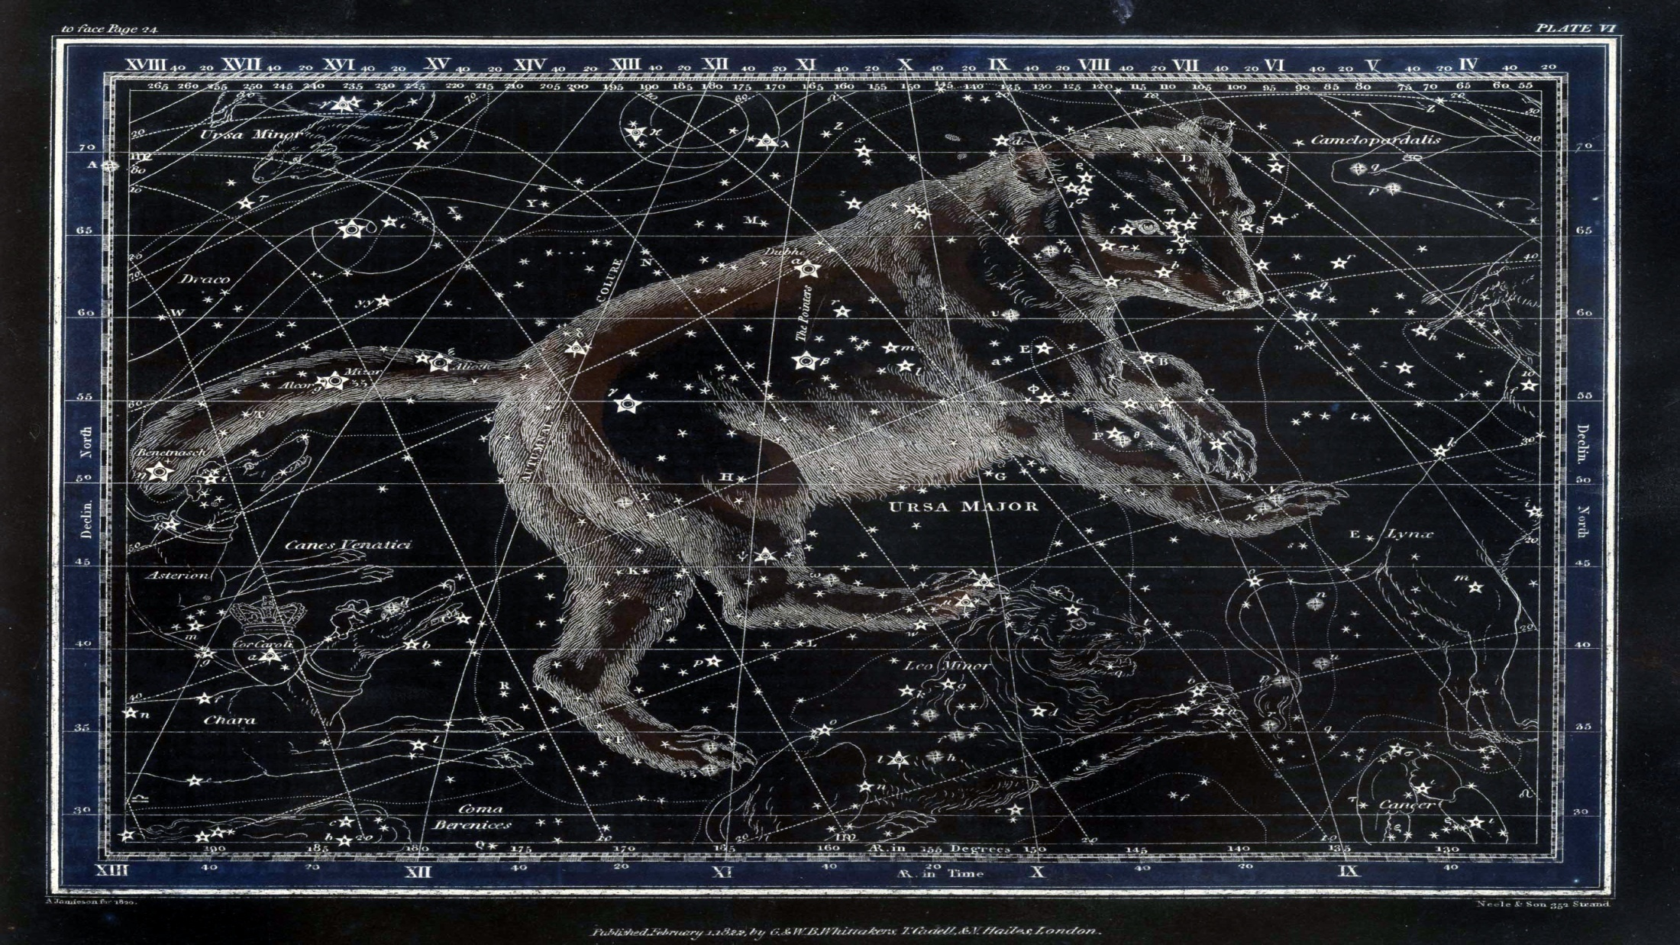


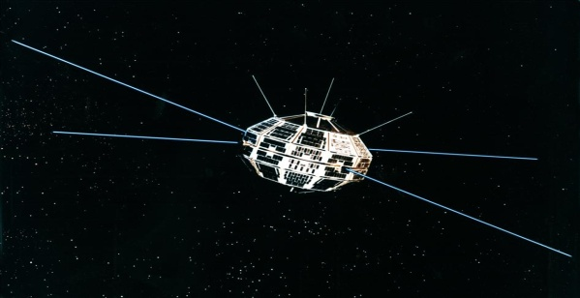



RASC 2018 Sesquicentennial
RASC—Eyes on the Universe for 150 Years
Jamieson, Celestial Atlas, 1822; image© RASC Archives
2017 RASC GA
Ottawa
RASC 2018 Working Group

Slide 2

RASC—Eyes on the Universe for 150 Years
www.rasc.ca/2018
RASC, 1868-2018, one hundred & fifty years of not-quite continuous existence, variously promoting astronomy and allied sciences—that’s reason to celebrate!
But how?

Slide 3
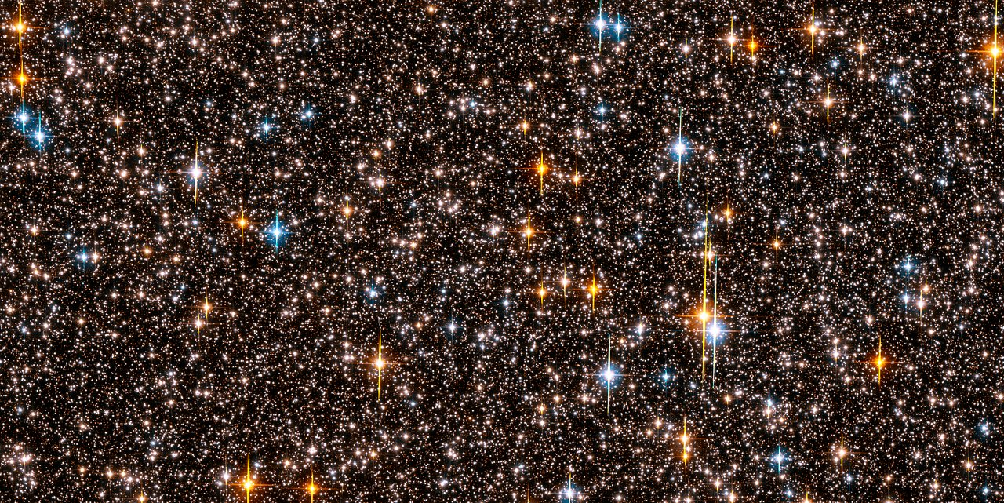






Not every “unique” idea seemed equally practicable, or to strike quite the right tone...
Clear skies! Clear skies!
Clear skies! Clear skies! Clear skies! Graaaagh!
Image © NASA; Zombies not © NASA
RASC—Eyes on the Universe for 150 Years

Slide 4

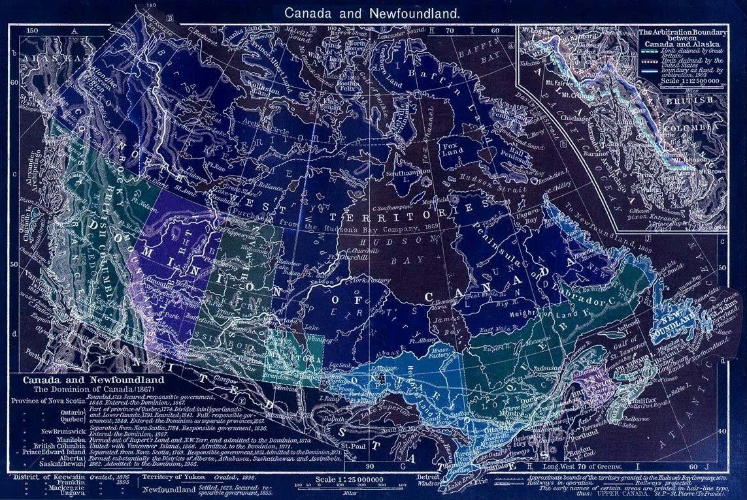

Opening event—the National Star Party
2018 January 27
eu
www.rasc.ca/2018
all Centres
ca. 3:00-8:00 PM local time, regardless of weather
solar & lunar observing, etc.
live streaming via rasc.ca, with Centre highlights
messages from luminaries, astronomical & civilian
map courtesy of retrospective 1867 politically-incorrect cartographic notions
RASC—Eyes on the Universe for 150 Years
Project lead—Paul Delaney

Slide 5
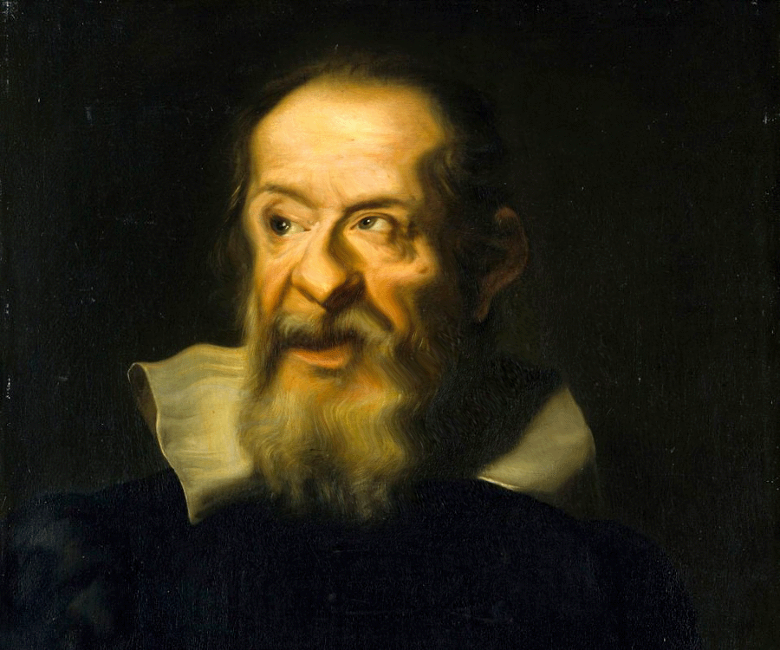

Cultural connections
www.rasc.ca/2018
An opportunity to partner with your favourite local arts organization(s), and renew—or initiate—collaborations to mutually explore the rich cultural connections between astronomy and other human endeavours.
For a list of resources, and possible ideas, visit:
RASC—Eyes on the Universe for 150 Years
...& I can
draw, play lute, & tell jokes, too
https://www.rasc.ca/cultural-connections-resources
Project lead—You!

Slide 6
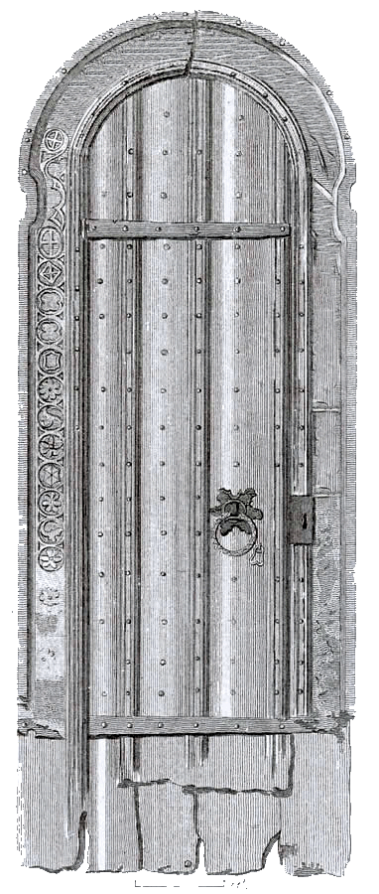


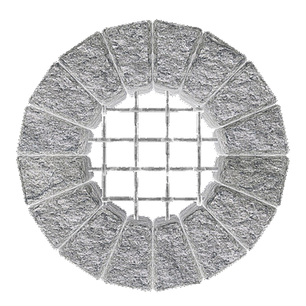
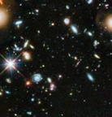


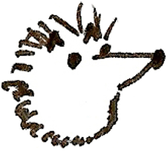
RASC 2018—the Podcasts
www.rasc.ca/2018
Curious about the old stuff which tells who we are, and what we’ve done since 1868? A series of podcasts will delve into the fascinating (& sometimes unbelievable) stories of the RASC, based on the surviving artifacts, the members who made and used them, and what we’re learned—and haven’t learned—about doing citizen science.
RASC Archives
RASC Archives
Vault
Enter at own risk!
Hardhat mandatory
Chain-mail advised
Please leave the dust as you found it!
Report any cases of decreasing entropy immediately!
episodes throughout 2018, with a new episode released each month
images of rare RASC artifacts and documents illustrating the podcasts will be on the website, with associated resources
learn, among other things, about how the RASC almost didn’t happen, and how some of the original founding documents disappeared, and then “miraculously” reappeared
vault
Project leads—R.A. Rosenfeld & Heather Laird
RASC—Eyes on the Universe for 150 Years

Slide 7
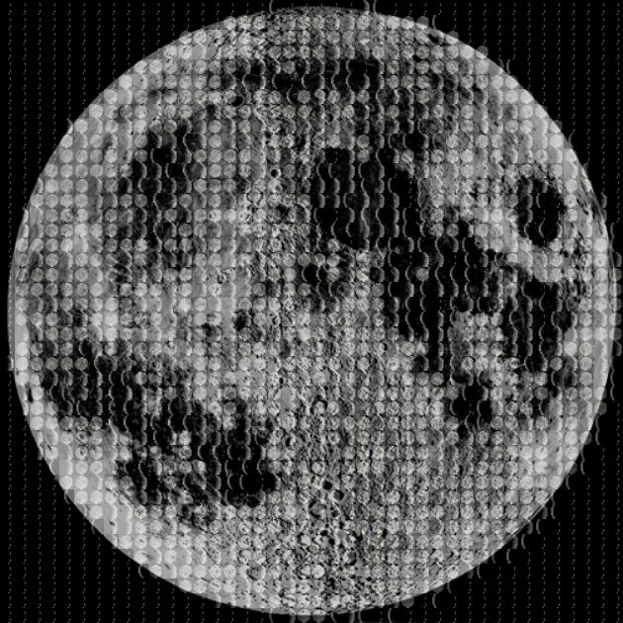

Canada Observes
At its best, the RASC is about collaboration, and cooperation. What better way to express that spirit, than to take part on the occasion of our sesquicentennial in the biggest RASC selfie ever! Images taken of Centres doing what they do best will be combined in a mosaic version of a RASC symbol to express the vitality of Centres’ EPO across the country, and that nationally the RASC is an effective and diverse unity made up of all of us. This project also envisions creating a mosaic image of an astronomical object made up of RASC members’ sketches and photographs of that celestial object or phenomenon—
we are, after all, about observing the
universe around us.
www.rasc.ca/2018
RASC—Eyes on the Universe for 150 Years
Both mosaics will be made available in two professionally designed banners, the files of which can be downloaded by Centres and members for display.
Project leads—June MacDonald & Heather Laird

Slide 8
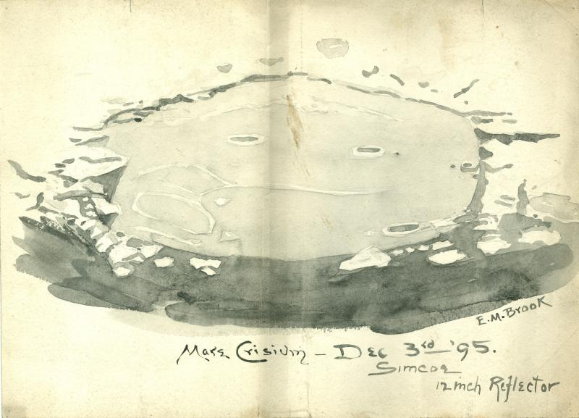
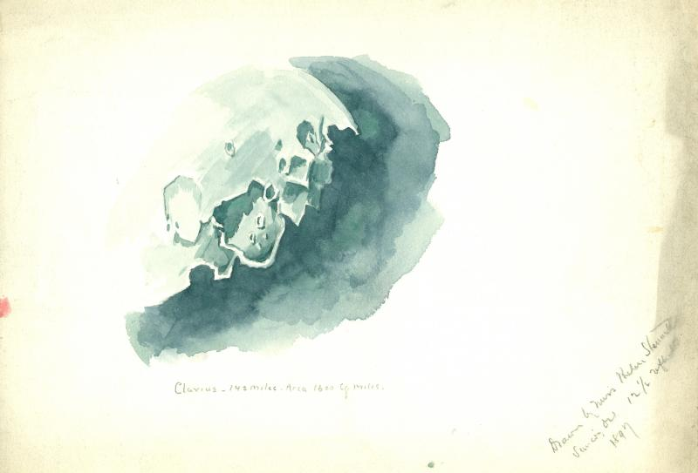
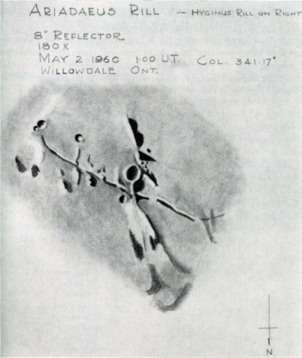
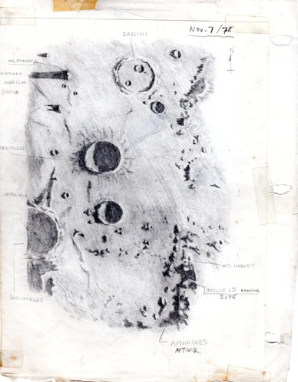
Viewing the Moon across Time
Have you ever wondered what it would be like to observe with RASC members of the past? Viewing the Moon across Time provides an opportunity to creatively enjoy the flavour of past amateur astronomy, through active engagement with its materials.
www.rasc.ca/2018
The resources provided will enable experimentation in exploring past styles of observing, in using earlier equipment and techniques (or their nearest modern equivalents), and in recapturing the intellectual formation of observers at key dates in the Society's past. The goal of this project is to broaden the observing experience of participants, through encouraging a creative and critical hands-on engagement with resources, techniques, and views unfamiliar to most contemporary observers, which will enrich the personal choices they can bring to their own observing craft, and expand the repertoire of material they can introduce into their EPO. The project webpage will feature many of the historical observing resources, and provide links to others.
Project lead—R.A. Rosenfeld
1895 Eva Brooks
1897 Helen Stennett
©
© RASC Archives
© JRASC
©Peter Daniels
RASC—Eyes on the Universe for 150 Years
© © RASC Archives
1962 Lorne Jewett
1978 Peter Daniels

Slide 9





RASC 2018 anniversary imaging competition
As part of our 2018 sesquicentennial celebrations, the Royal Astronomical Society of Canada will invite Canadians to observe the astronomical sky and share their impressions through photography, sketching, or other artistic expression (e.g., sculpting, print making, textile artistry, videography, etc.). We particularly welcome and encourage young people and newcomers of all ages to engage and share their inspirations.
There will be separate categories for experienced astrophotographers (5 yeas or more in the field), intermediate astrophotographers (less than five years), and beginners—those who have taken up astrophotography in 2018.
Public voting will determine the winners in the categories.
www.rasc.ca/2018
Project leads—Jim Hesser & Lauri Roche
RASC—Eyes on the Universe for 150 Years

Slide 10

The RASC at 150
www.rasc.ca/2018
To mark the centenary of the RASC in 1968, the Society published a brief collection of papers surveying some aspects of the history of Canadian astronomy: Astronomy in Canada: Yesterday, Today, and Tomorrow. As much of the story of Canadian astronomy remains to be told—particularly the amateur and pro-am aspects—the RASC’s sesquicentennial can be fittingly celebrated by chronicling more of our story.
The RASC at 150 has two parts; the first will be a workshop under the aegis of the 2018 GA, where new research on the RASC’s role in Canadian astronomy will be presented by invited speakers. The second is the publication (ca. 2019-2020) of an illustrated book based on those talks.
It is anticipated that The RASC at 150 will be a substantial contribution to the literature on Canadian astronomical history and heritage, and a legacy project.
RASC—Eyes on the Universe for 150 Years
Project leads—R.A. Rosenfeld & Heather Laird

Slide 11
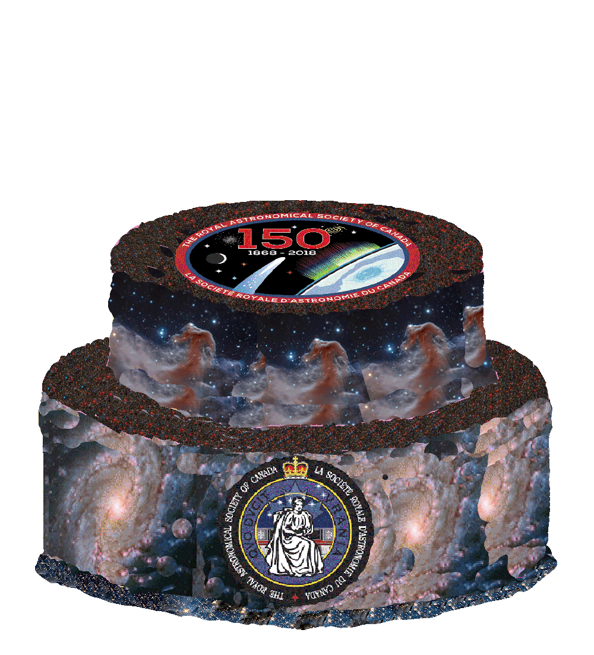

RASC—Eyes on the Universe for 150 Years
www.rasc.ca/2018
Happy Birthday!

