Slide 1
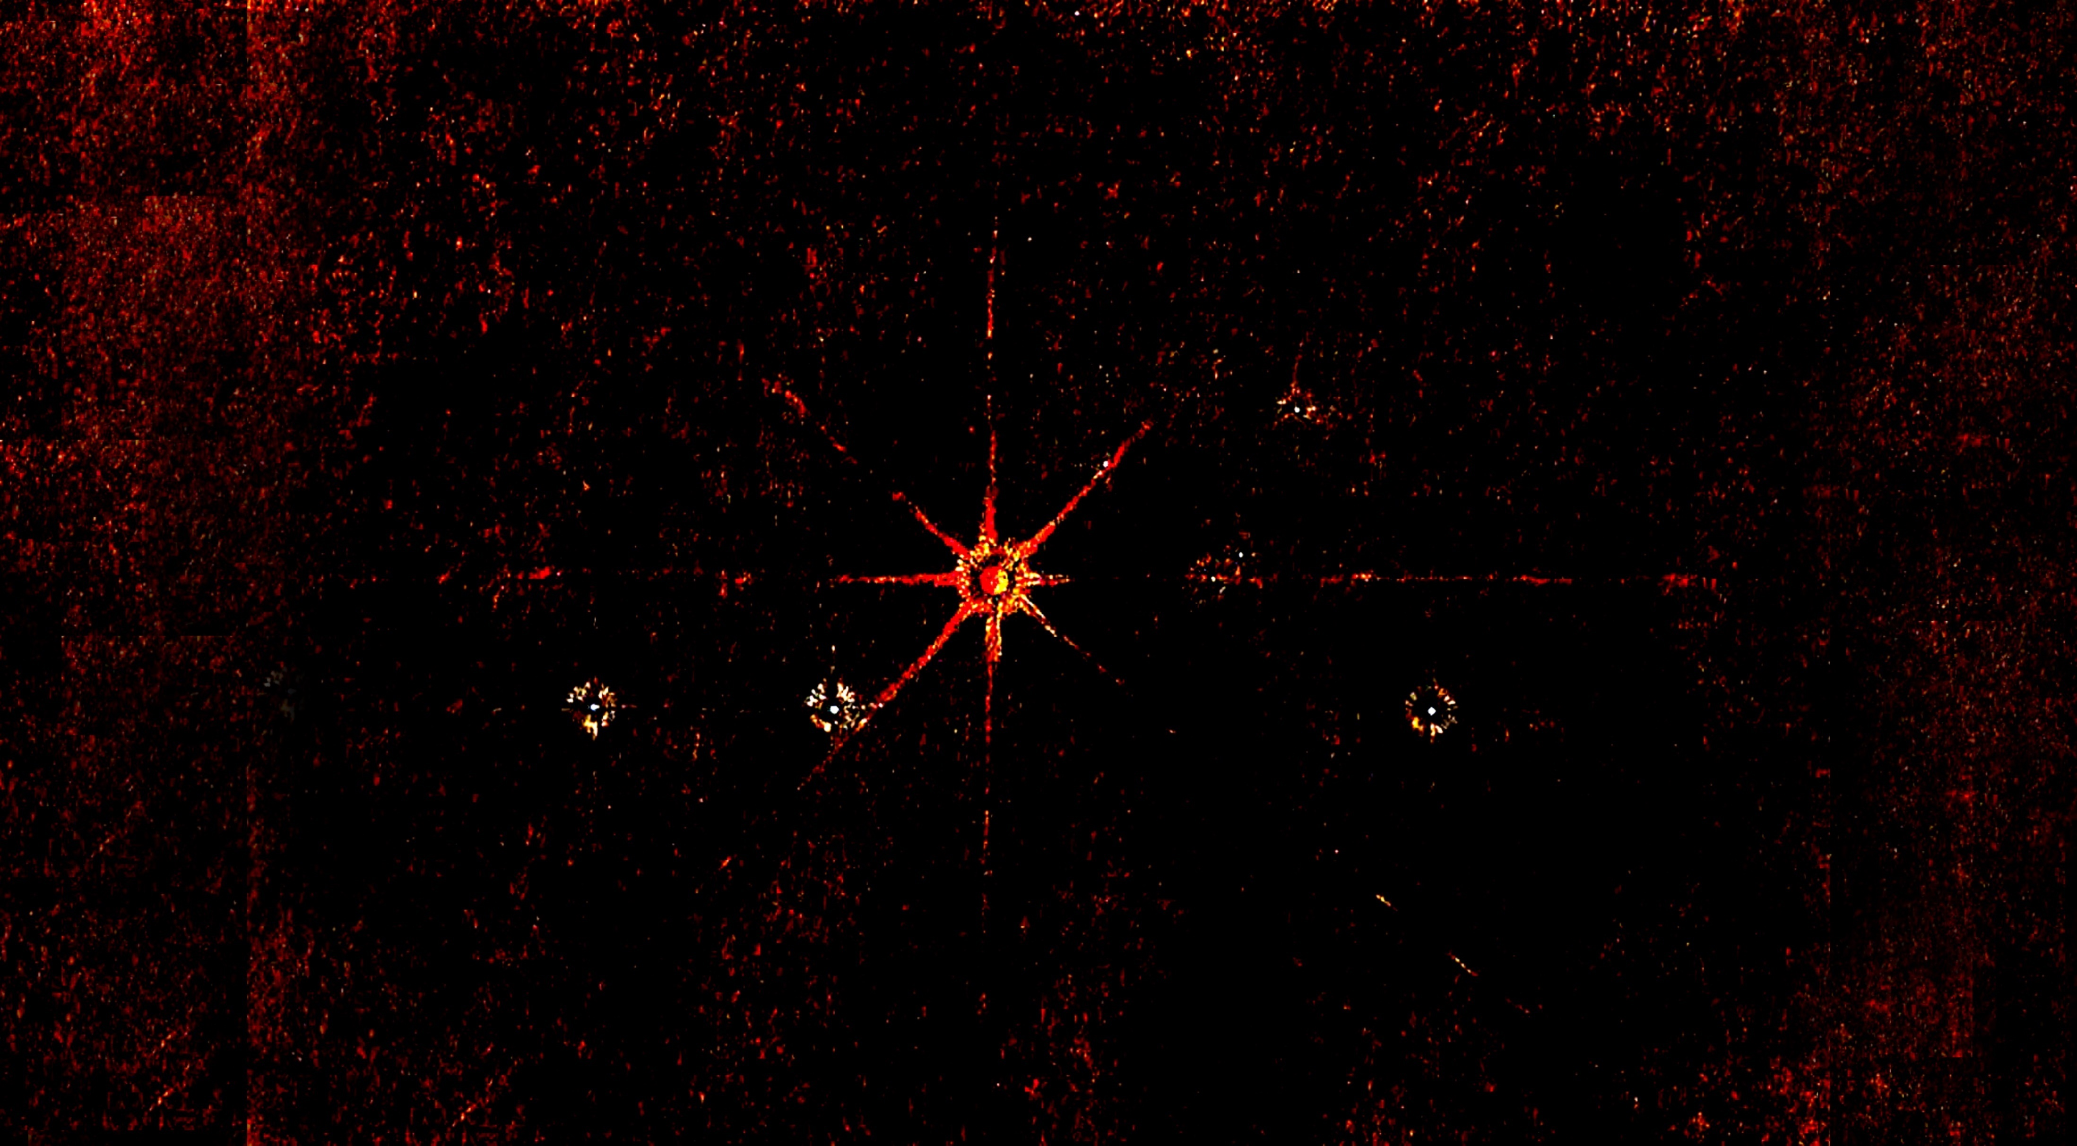

Mars through the eyes of the RASC:
the visual evidence from past oppositions
RASC History Committee Seminar Series
2020 October 26
R.A. Rosenfeld, frasc

Slide 2
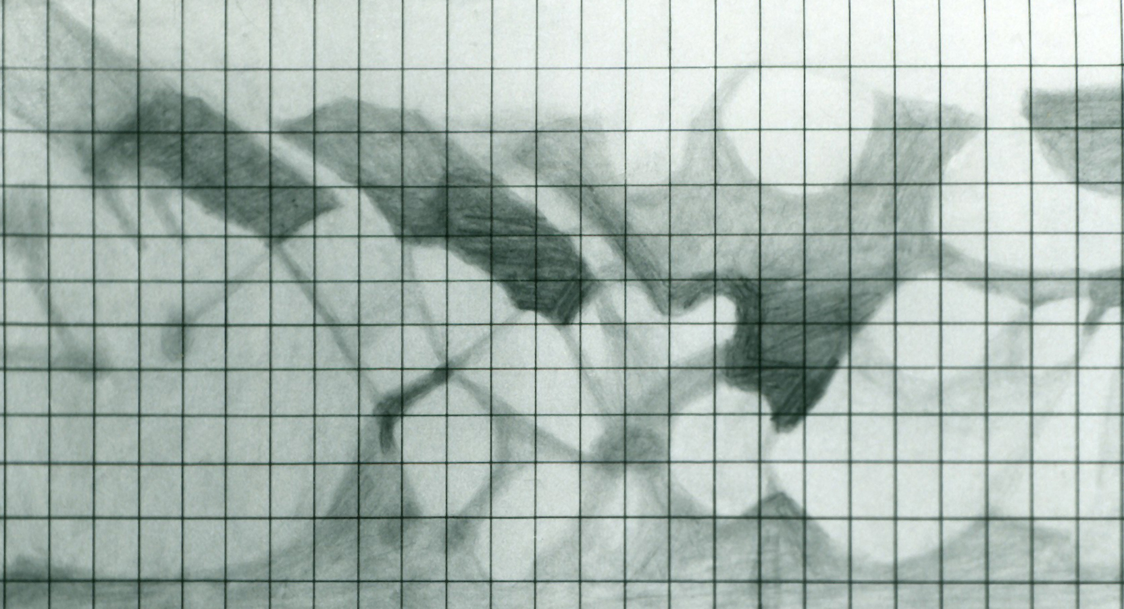
Thank you for joining us tonight, for the first session of the RASC History Committee Seminar Series!
Mars is topical, so we’ll look at representative images in the RASC Archives from past oppositions of Mars, with an eye to:
the instruments & media use;
the non-observational factors possibly influencing what was seen at the eyepiece; &
what other observes in comparable organizations were doing.
And we might even ask what our perspective on past visions of the red planet teach us about our own observations at this, and future oppositions.

Slide 3
The RASC and Mars…
at the very first real meeting of the The Toronto Astronomical Club: “Mr. Elvins produced a drawing of the appearance of Mars as observed by him Dec 29th 1868”; Toronto Astronomical Society Meeting Minutes, Regular Meeting Jan 5th 1869 at Mr. Elvins’
a suitable object for group observing: “The earlier part of the evening was spent in observing the moon, Jupiter, and Mars, with portable telescopes, provided for the purpose. The air being steady and very clear, some excellent views were obtained”; thirteenth meeting, 1890 September 23, Transactions of the Astronomical and Physical Society of Toronto 1890-91 (1891), 13
developments in the wider astronomical world are followed: “Mr. Larratt W. Smith, Q.C., D.C.L., Vice-President, in the Chair. Mr. A. Elvins called attention to the announced fact that the doubling of some of the lines on Mars, known as Schiaparrelli’s Canals, had been observed at the Lick and Arequipa Observatories during the favourable opposition of the planet in August”; nineteenth meeting, 1892 October 18th,Transactions of the Astronomical and Physical Society of Toronto 1892 (1893), 68
and observing advice is published: “...because of its position in our solar system, and still more because of its resemblance...to the earth...[Mars] is admitted by most astronomers to be more worthy of careful study than perhaps any other member of the sun's family. There is however no reason why the owner of any good telescope of three inches aperture or upward, (or even a smaller one if of fine quality). should not turn it to account for Martian study, and if he will but do so diligently, frequently and carefully, he will soon find the work deeply interesting...”; A.F. Miller, “Observing Mars with a Small Telescope”, JRASC XII, 5 (1918 May-June), 190
clearly there’s interest—the Society is a microcosm of amateur, professional, and popular curiosity about Mars in general (but there are “local” differences—stay tuned!)

Slide 4
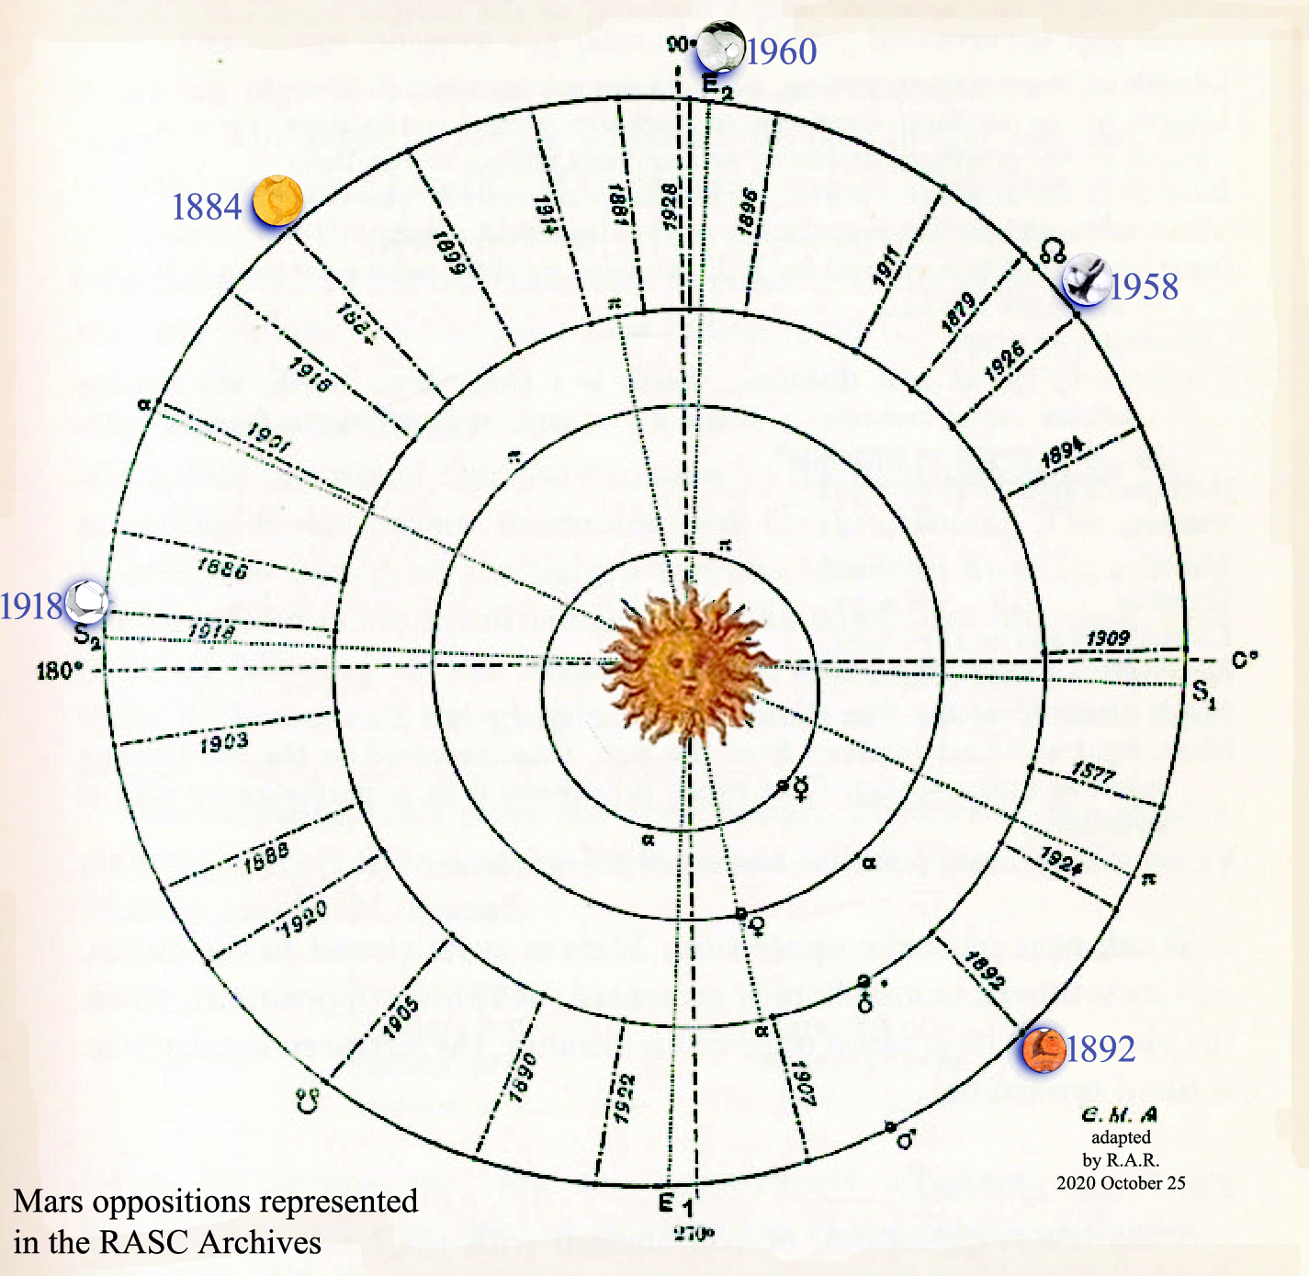
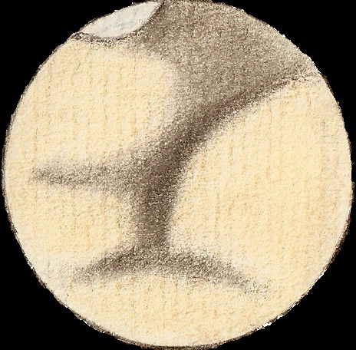
There’s less in the Archives then we might hope; survival depends on foresight of past & present members,
care, & luck There are drawings from the oppositions of (1884), 1892, 1918, 1958, & 1960

Slide 5
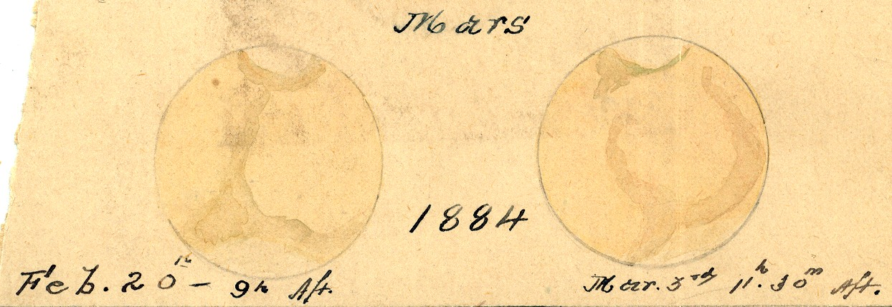
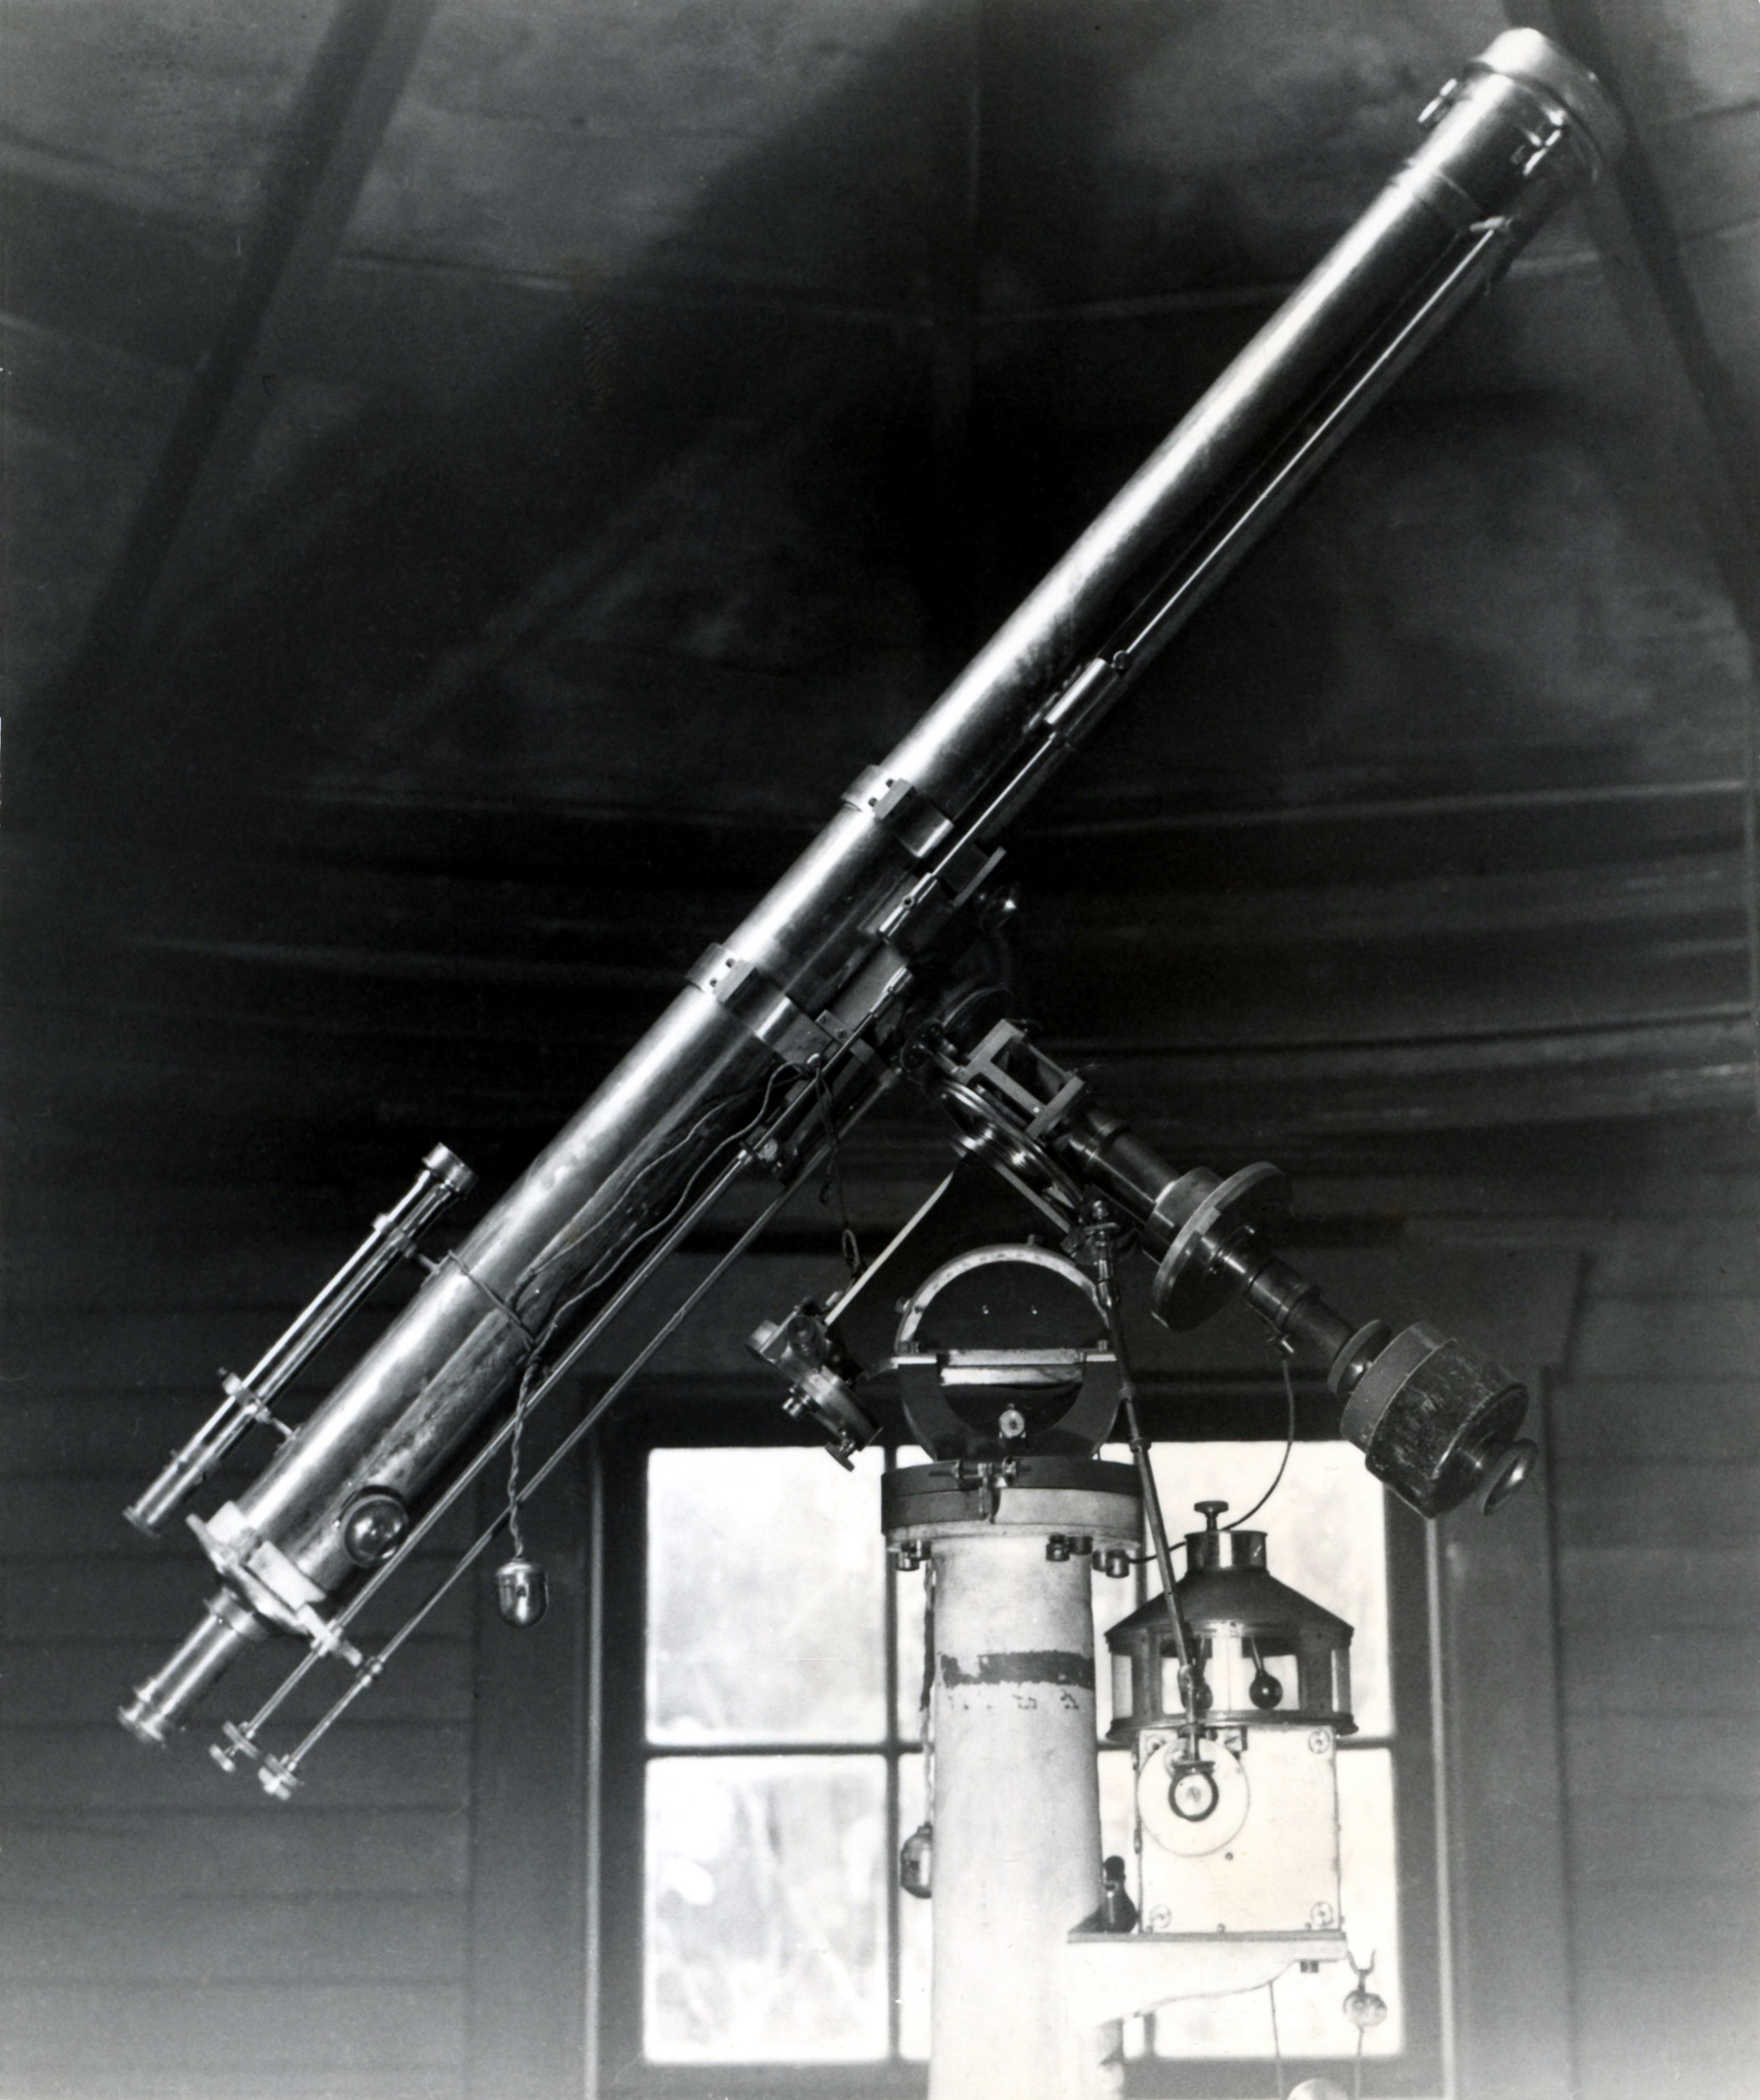
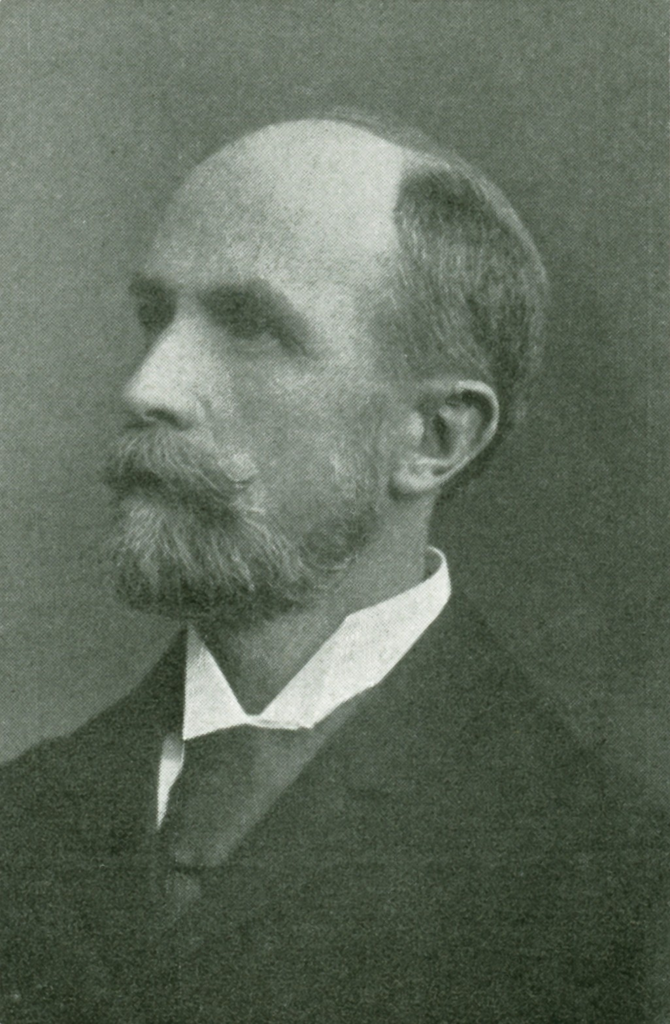
[1884]
Allan F. Miller (1851–1947), a hospital administrator, & eventually an amateur member of the IAU, had his own observatory with a high-quality 4-inch O.G. Wray refractor.

Slide 6
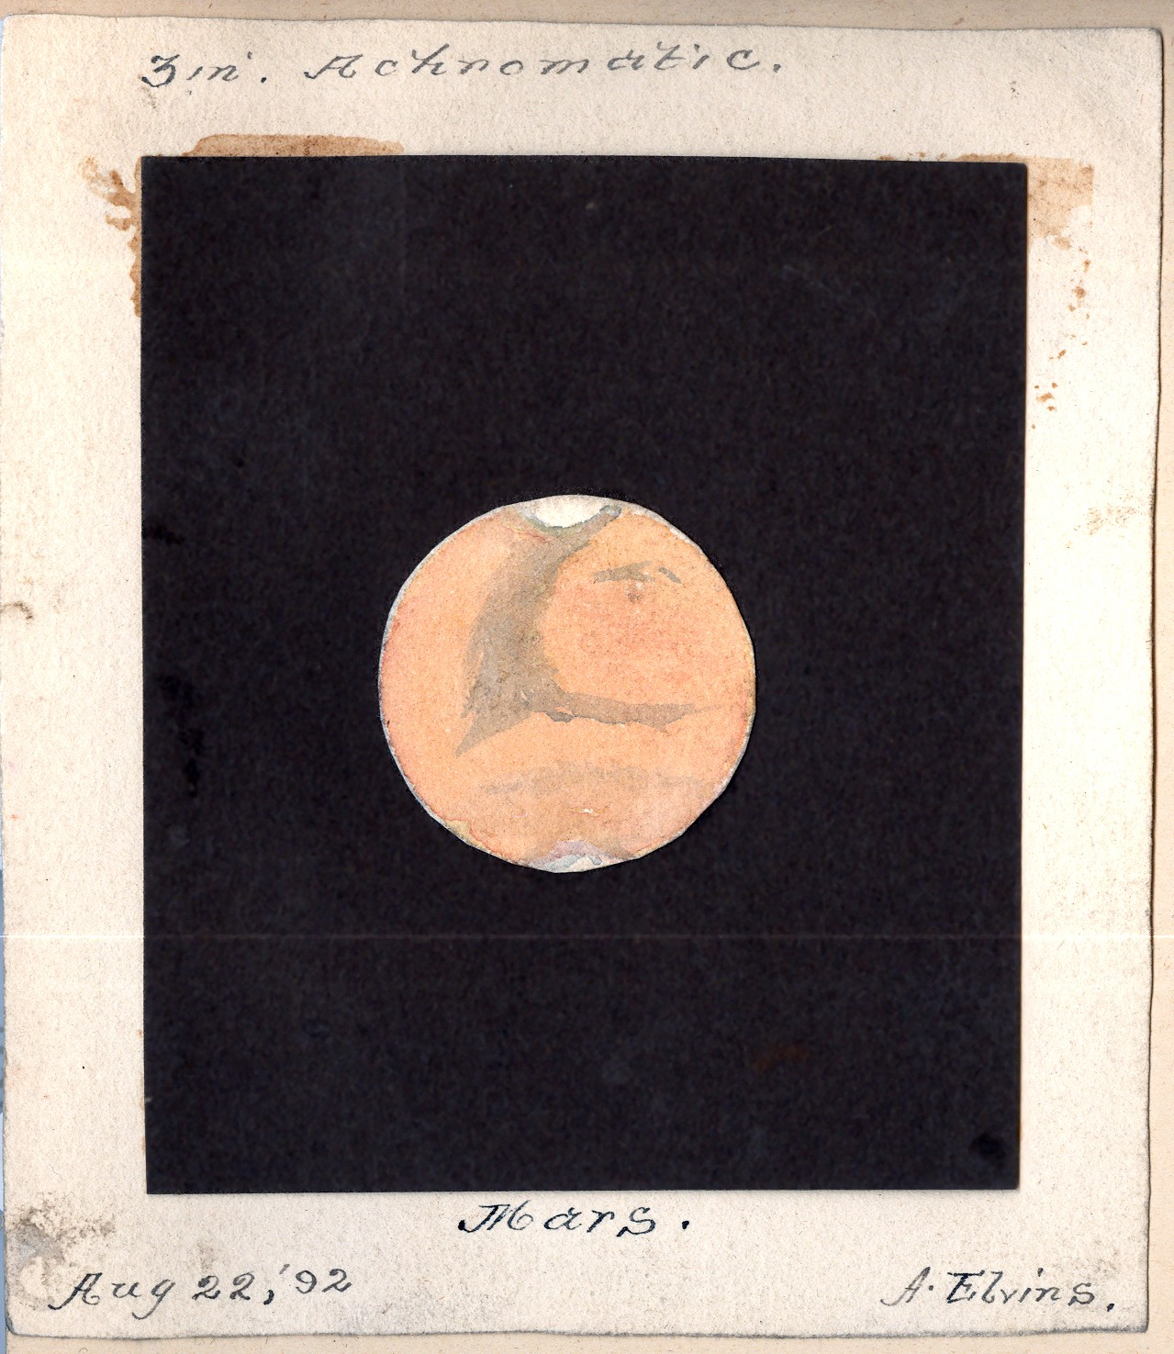
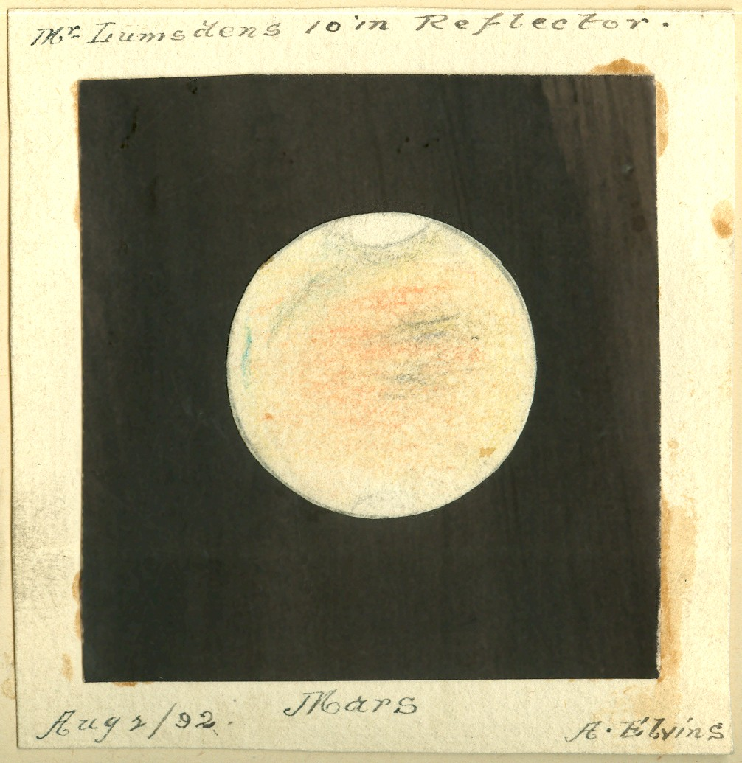
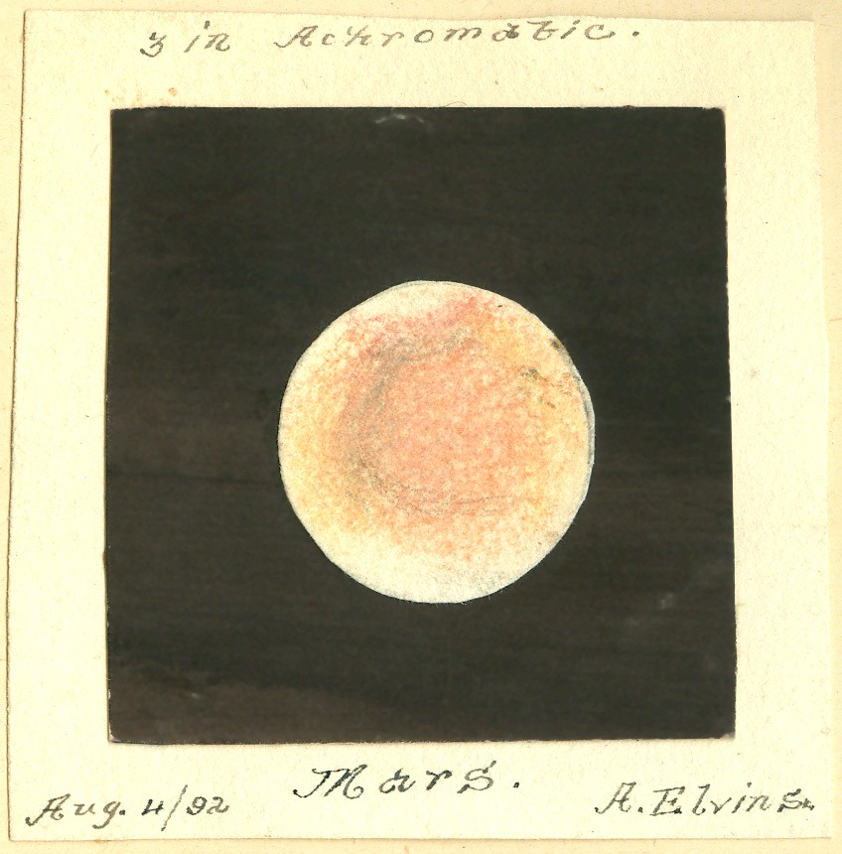
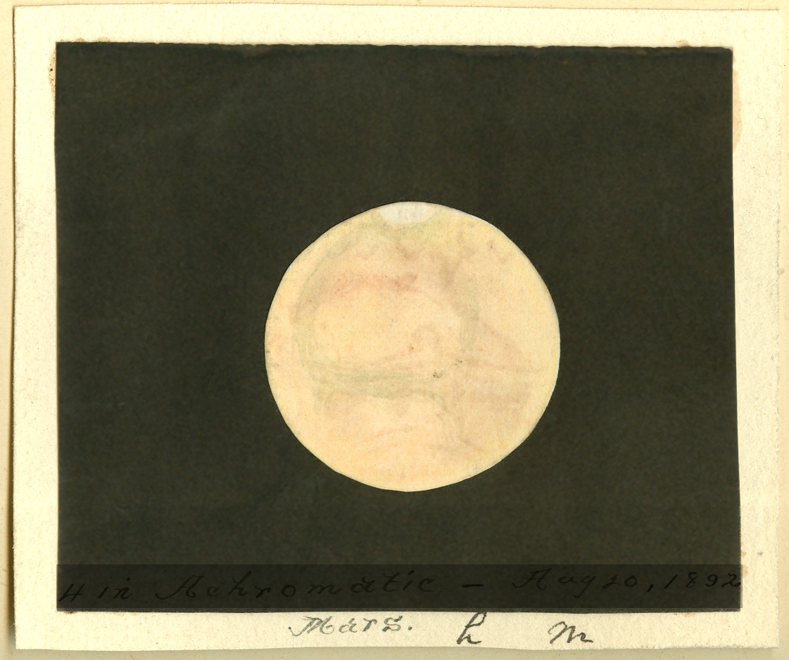
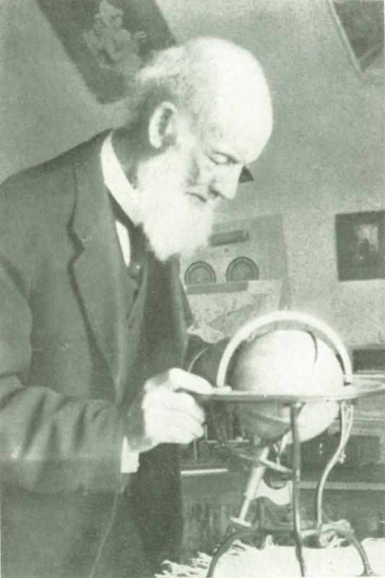
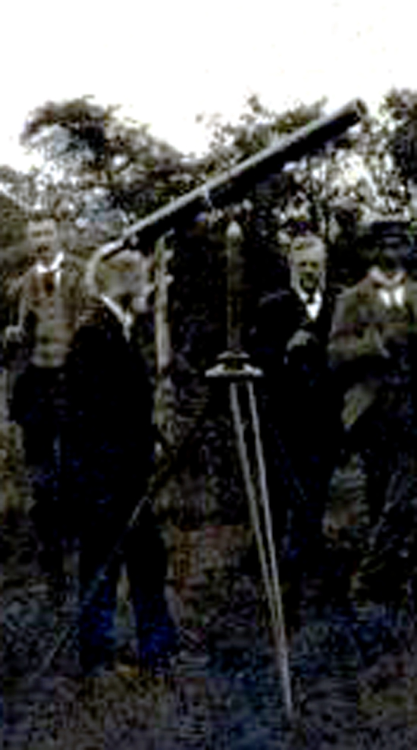
1892
Andrew Elvins (1823-1918), character who probably did the most to keep what became the RASC alive between 1869-1890, was a professional tailor. He used a 3-inch O.G. refractor (and, at later oppositions, Miller’s 4-inch, Lumsden's 10-inch reflector , and the 6-inch O.G. Cooke refractor of the Toronto Magnetic & Meteorological Observatory).

Slide 7
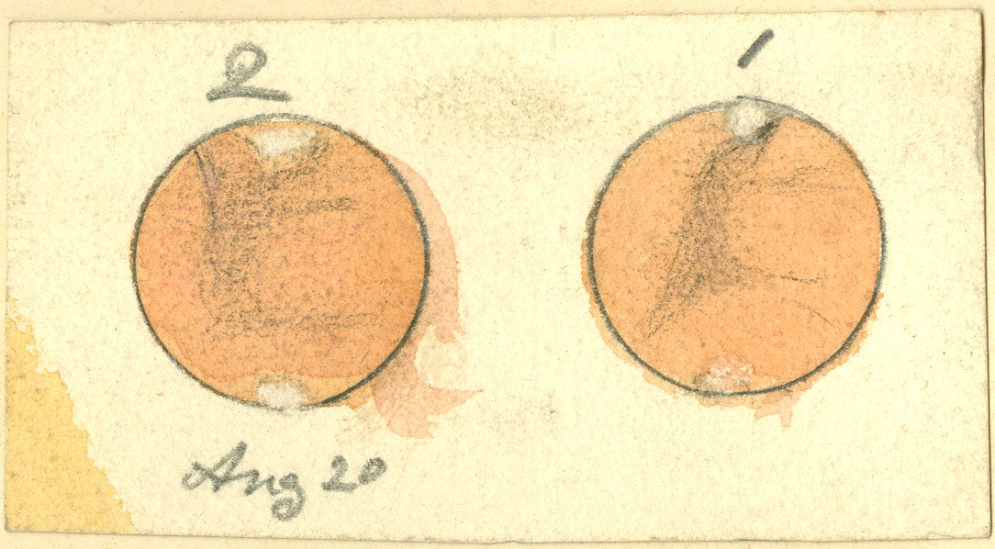
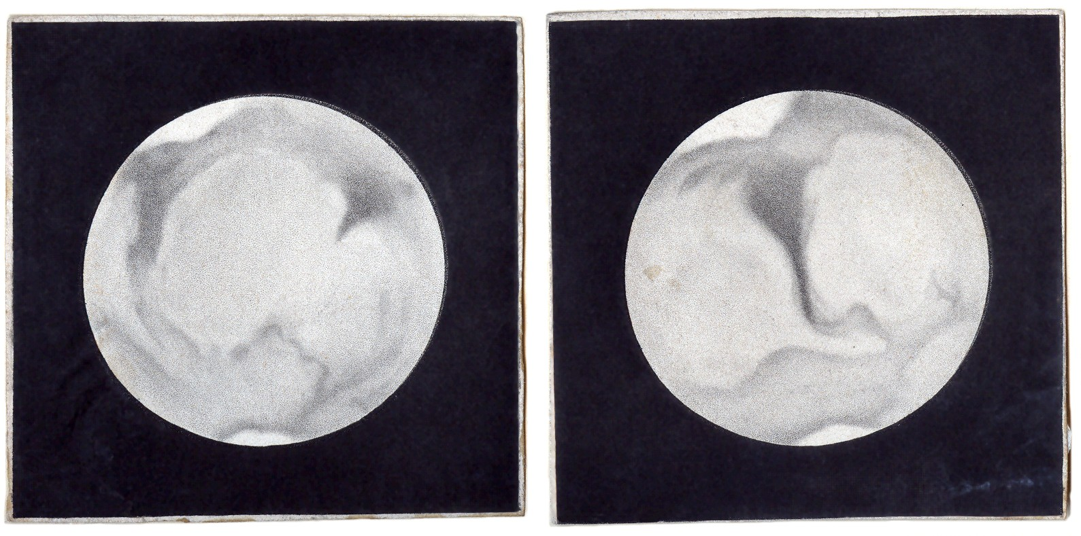
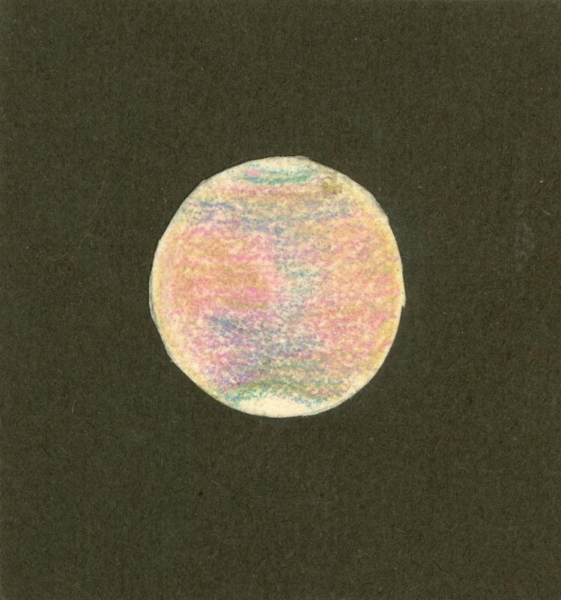
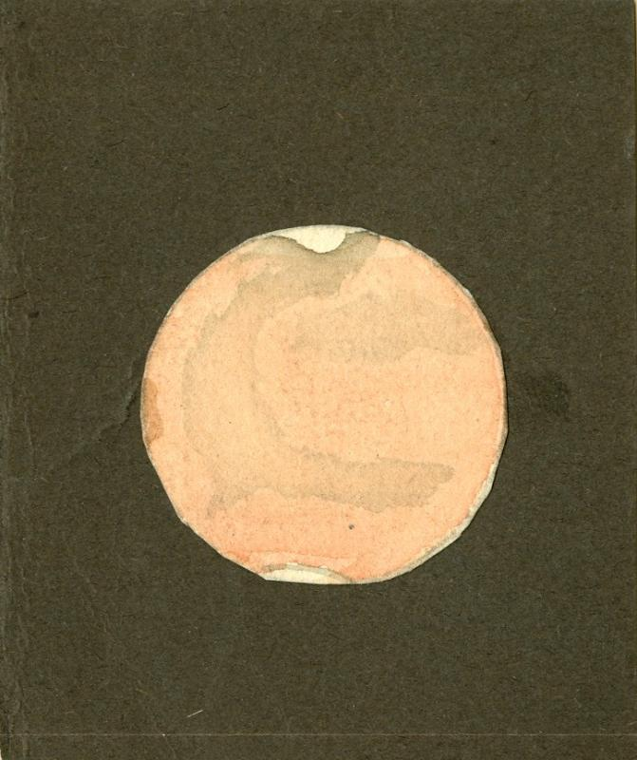
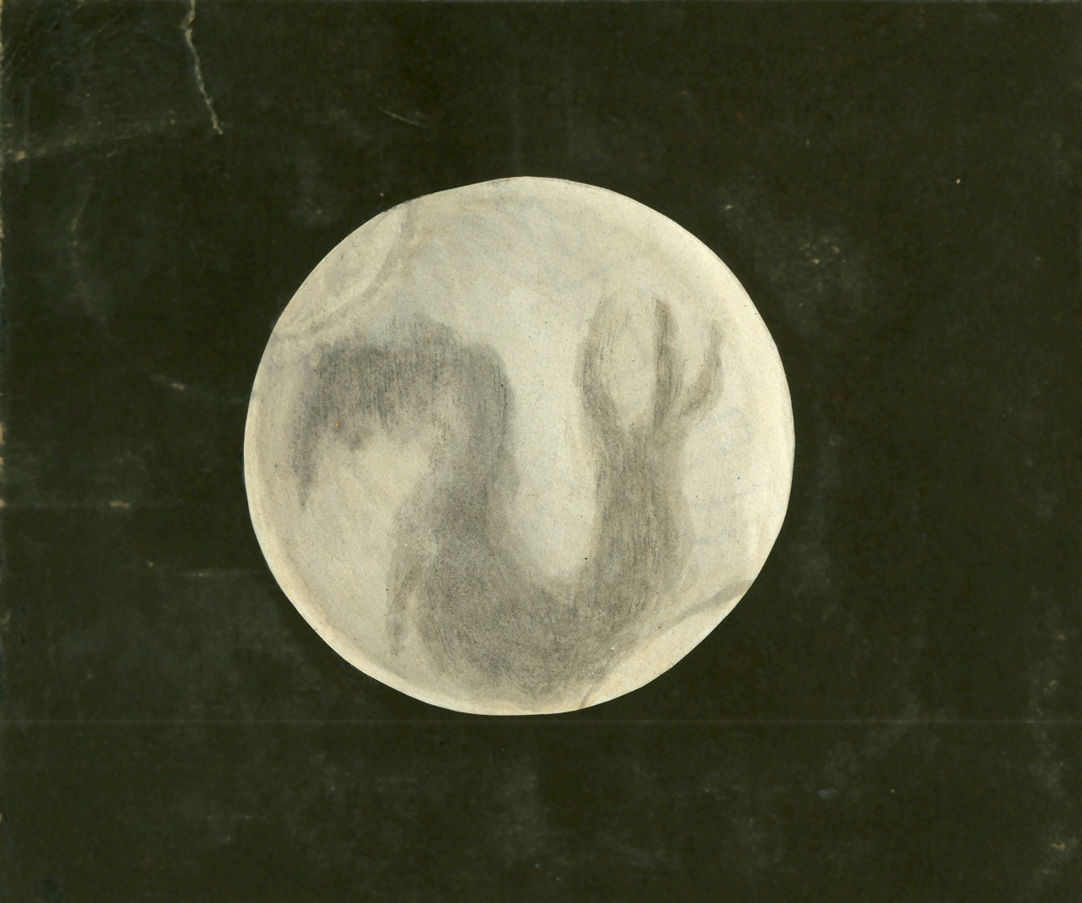
undated (1868?-ca. 1900s?)
Elvins “Aug 20”
Elvins
Elvins
Elvins
Elvins

Slide 8
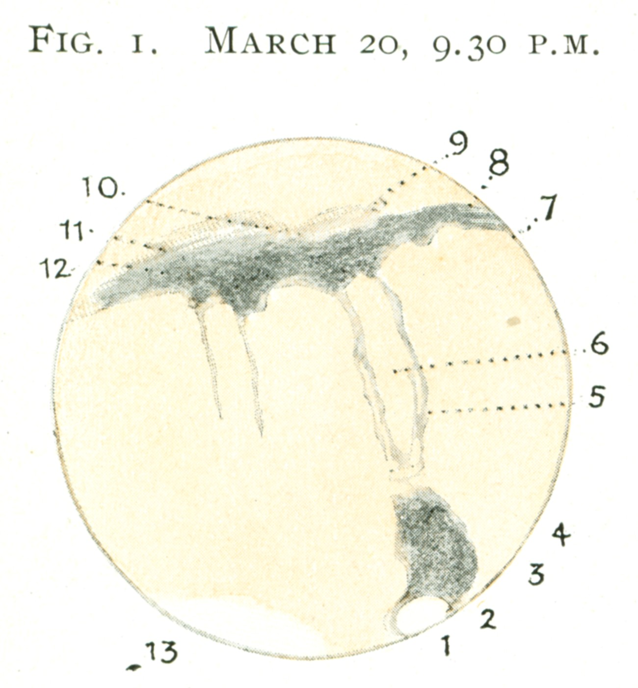
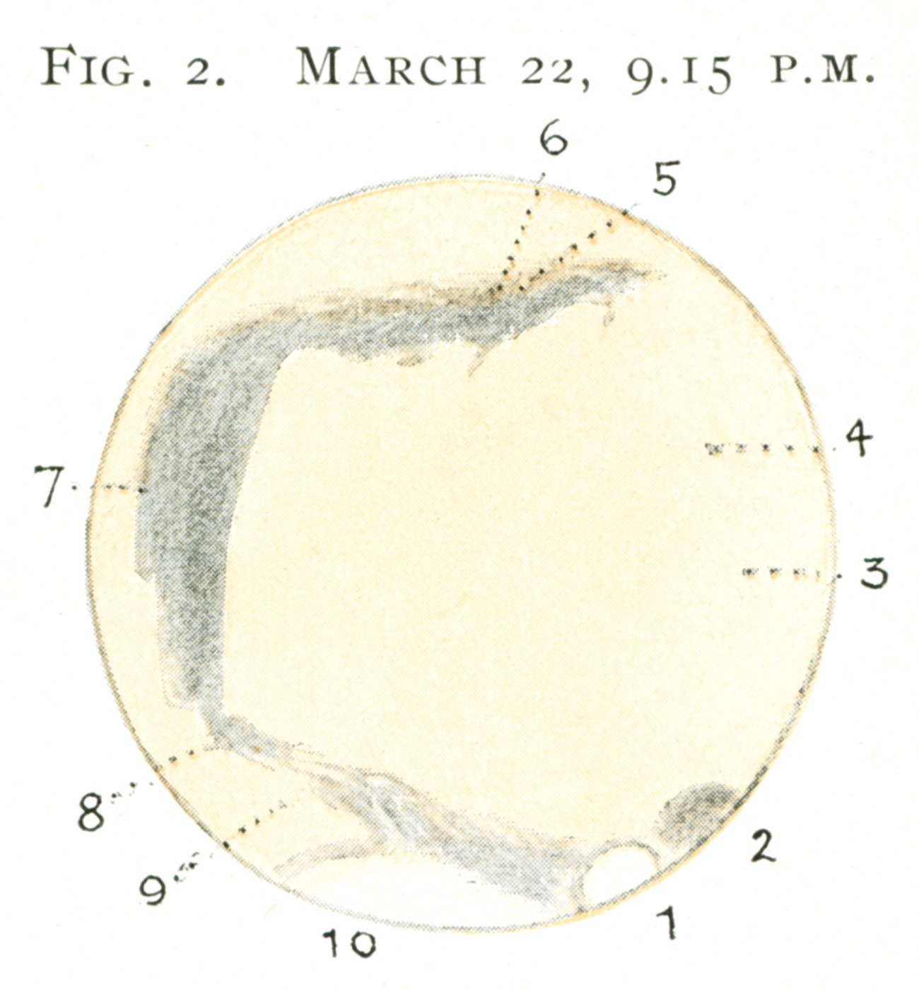
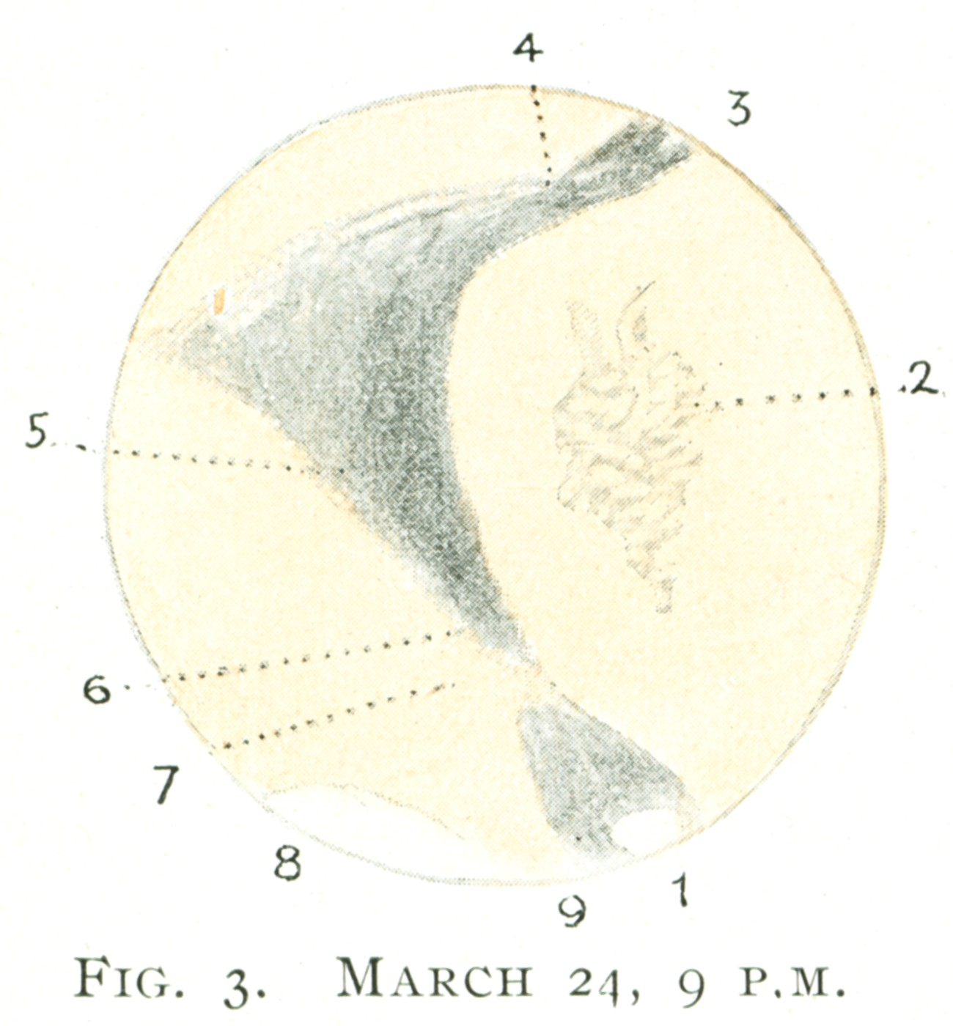
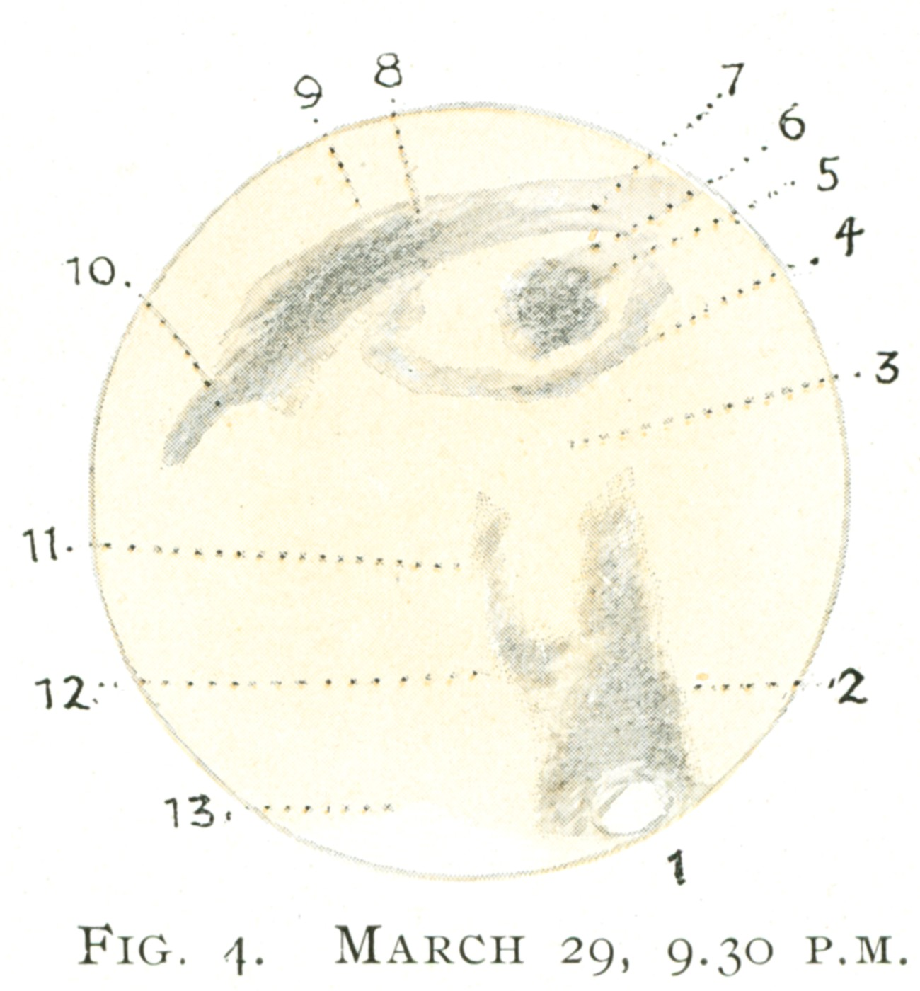
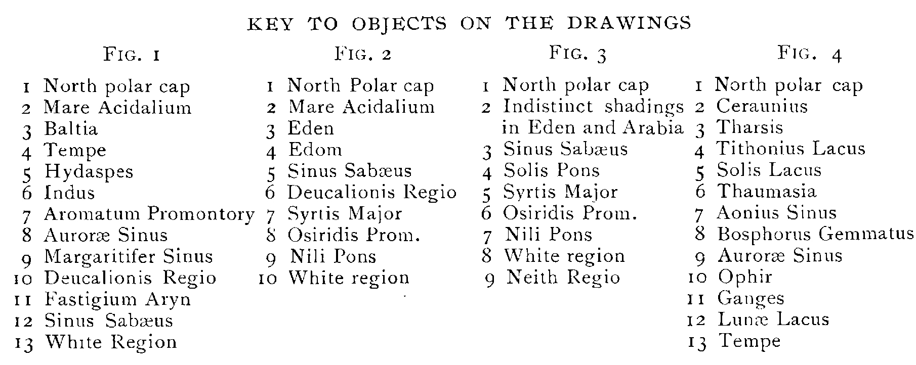
1918…
These images were published in A.F. Miller, "Observing Mars with a Small Telescope", in JRASC 12, 5 (1918 May-June), 190-194
Miller

Slide 9
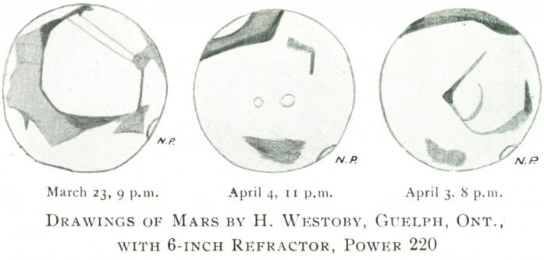
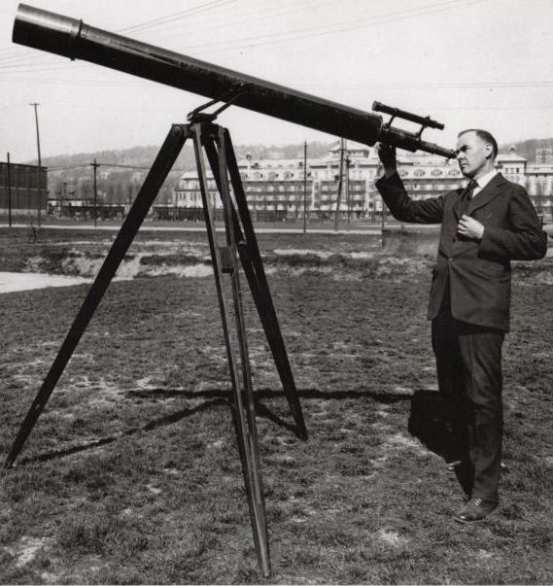
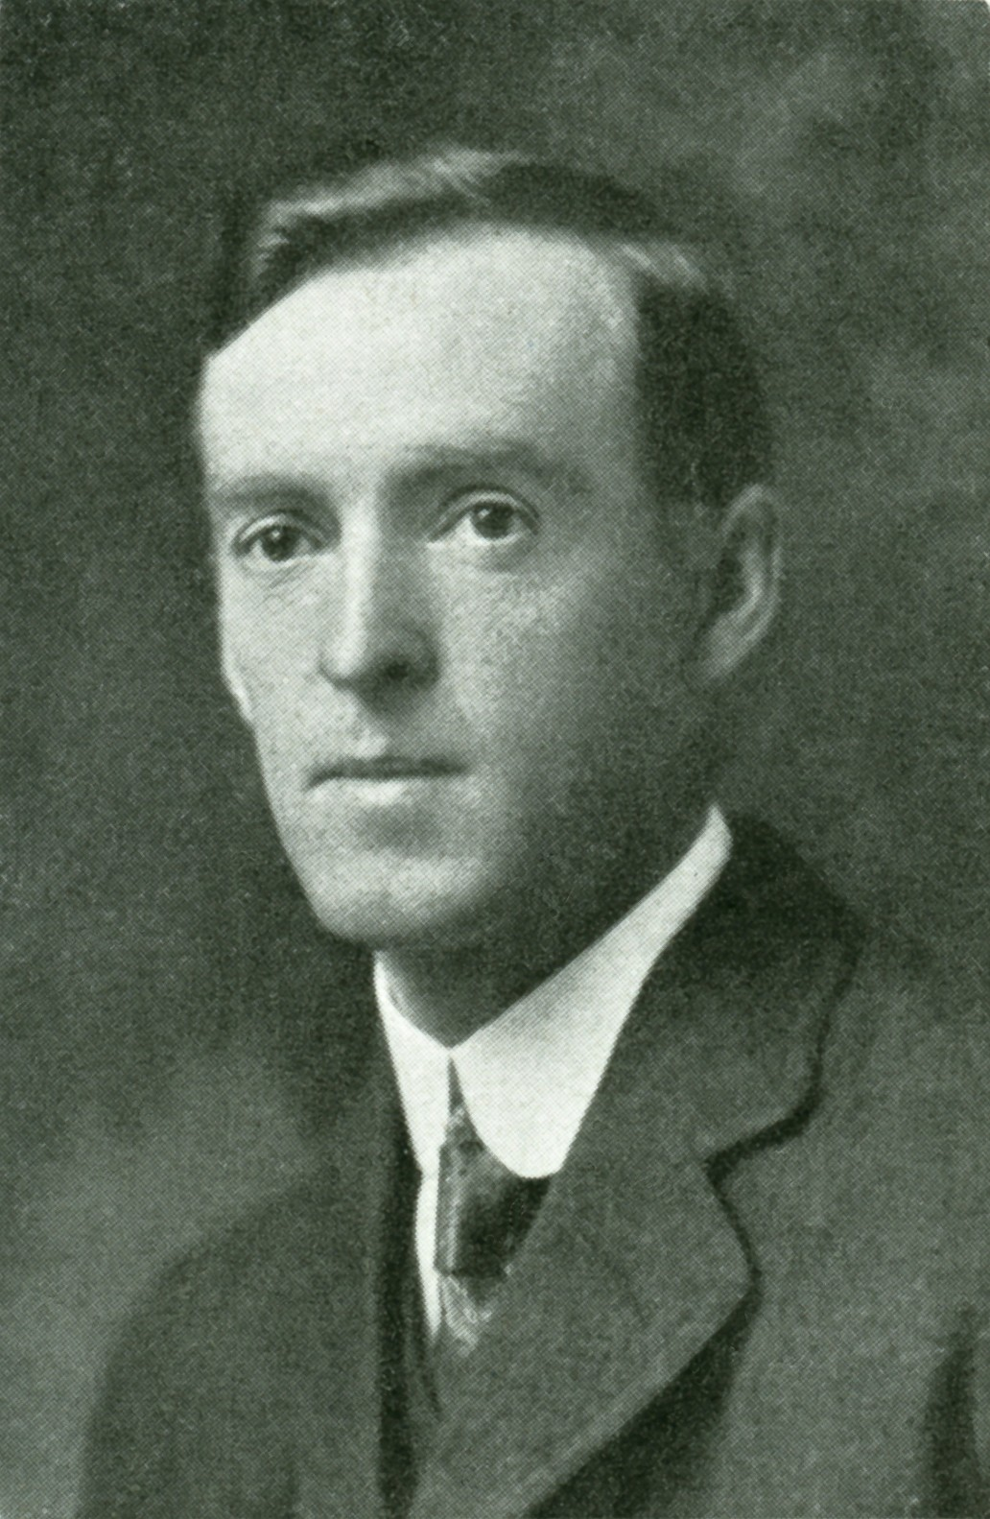
…1918
Westoby
Henry Westoby (1876-1965), first mentioned in JRASC in 1911 as a “charter member” of the Guelph Centre & its first President, and last mentioned in 1951 as that Centre’s Honorary President. The 6-inch refractor was probably the one which belonged to the Guelph Centre, and was in the keeping of H.E.S. Asbury.

Slide 10
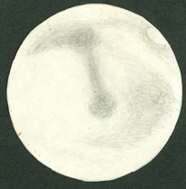
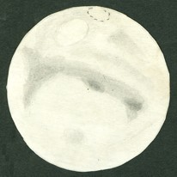

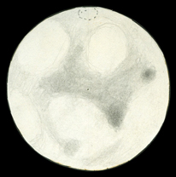
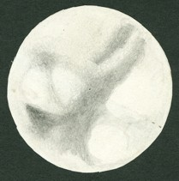
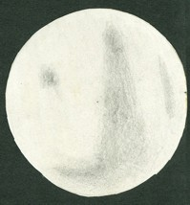
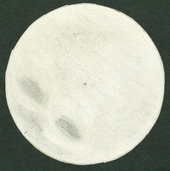
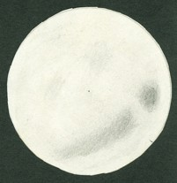
1958
1958 Nov 01 2100 EST seeing 2-3 sm
1958 Nov 02 2130 EST seeing 4
1958 Nov 04 2100 EST seeing 2-3
1958 Nov 7 2100 EST seeing 3-4 sm
1958 Nov 09 2000 EST seeing 2 sm
S.A. Zielinski, observing in Quebec. He used a a 10-inch f/7.2 reflector, x150.
1958 Nov 12 2000 EST seeing 3 sm
1958 Nov 22 2000 EST seeing 3
1958 Nov 27 2100 EST seeing 5

Slide 11
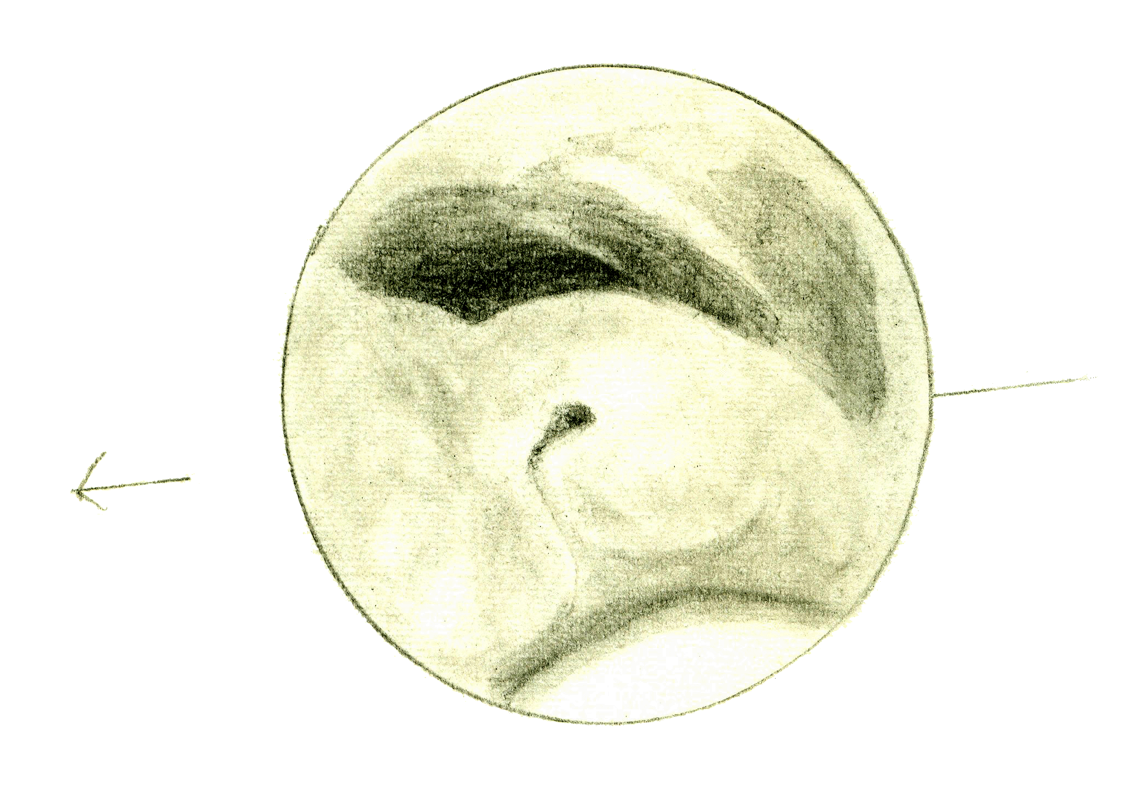
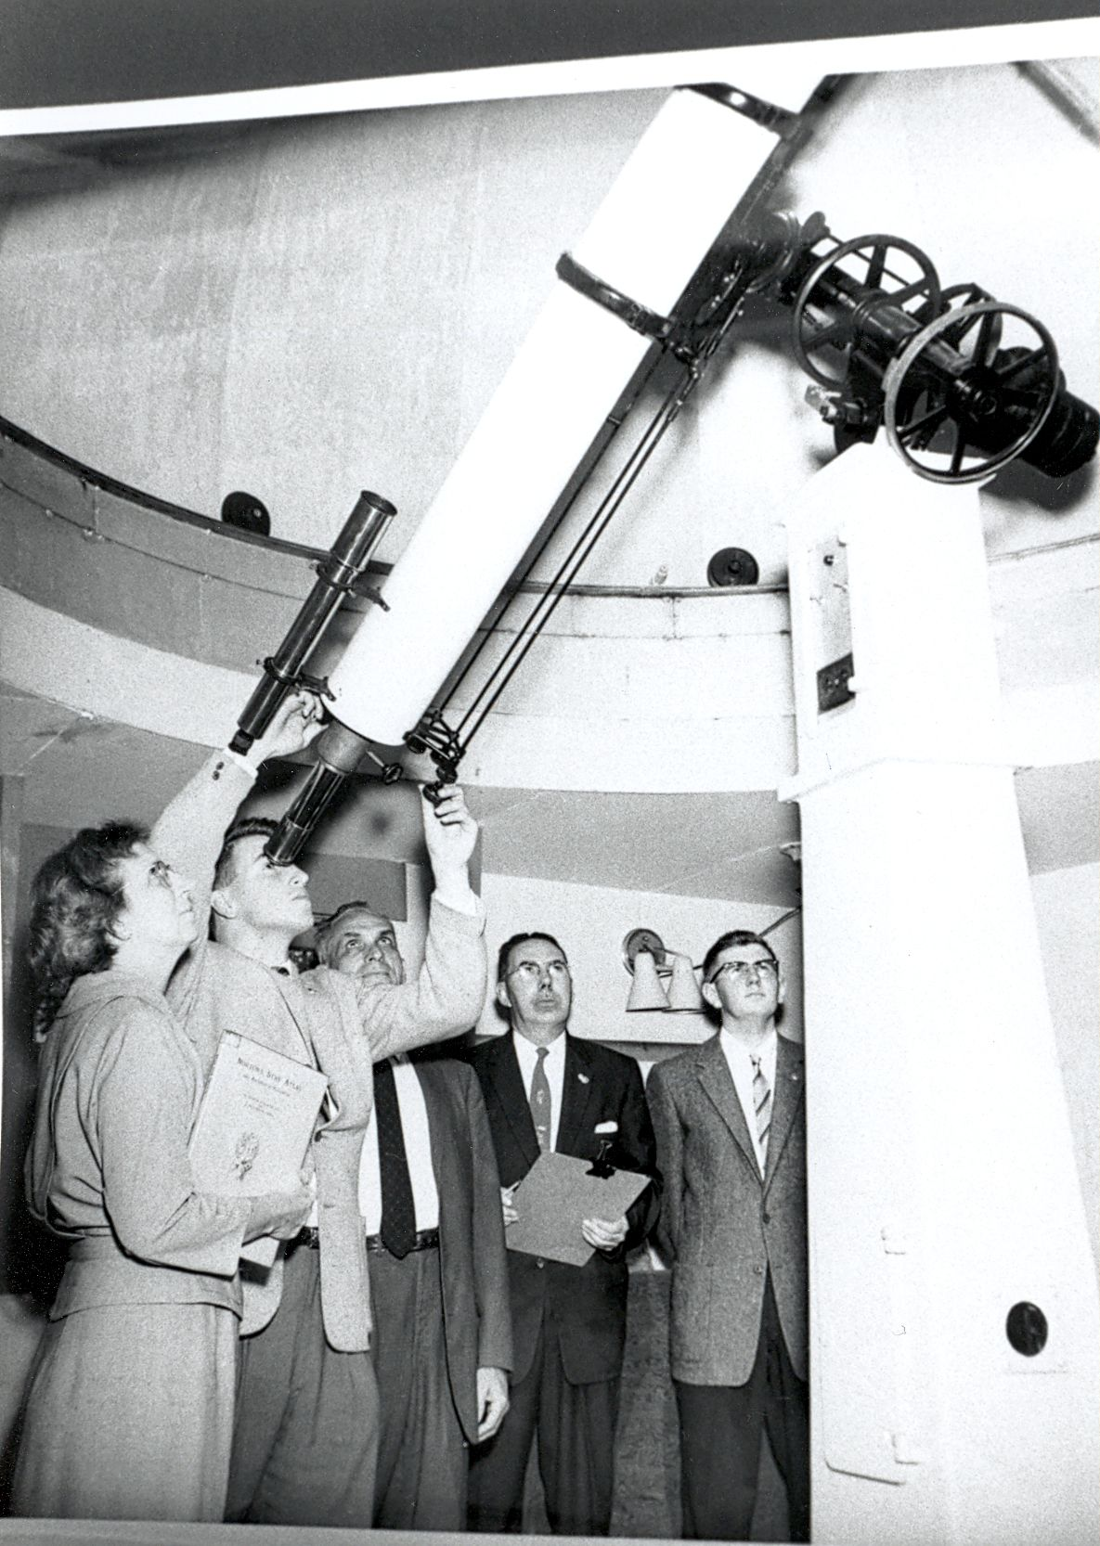
1960(-1961)
The first (and most notable example) of a RASC team effort at planetary imaging and mapping through astrosketching was by members of the Montreal Centre ca. 1960. Dr. Geoff Gaherty (1941-2016) effectively lead the Mars project, and remarked it was for a “term project for a course in cartography which I was taking at McGill that spring”. Notable contributors included Klaus Brasch and Constantine Papacosmas, among others. The chief instruments used were the Centre’s 6-inch refractor, and a 8-inch reflector.
Mars on 1960 December 3/4 at 23:00-23:30 local time (04:00-04:30 UT) as sketched by K.R. Brasch. C.M. 207°. 8" reflector at 300x. Seeing 5-2. Transparency 3-4. Colour contrast very great, dark regions greenish-brown and surrounding area bright rust-red. N. polar region glittering white. 1 canal seen. T = 7°

Slide 12
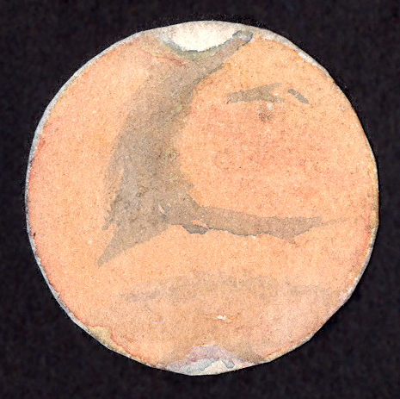
1892
1892

Slide 13
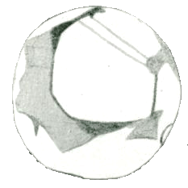
1918

Slide 14
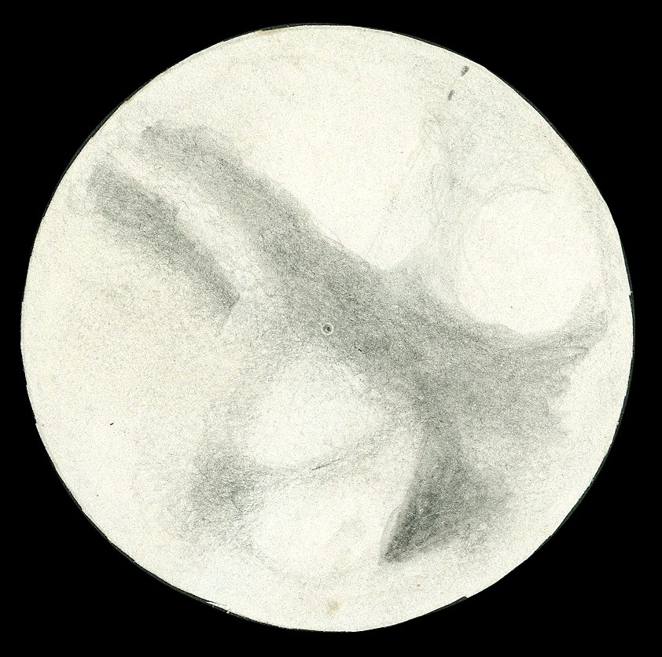
1958

Slide 15
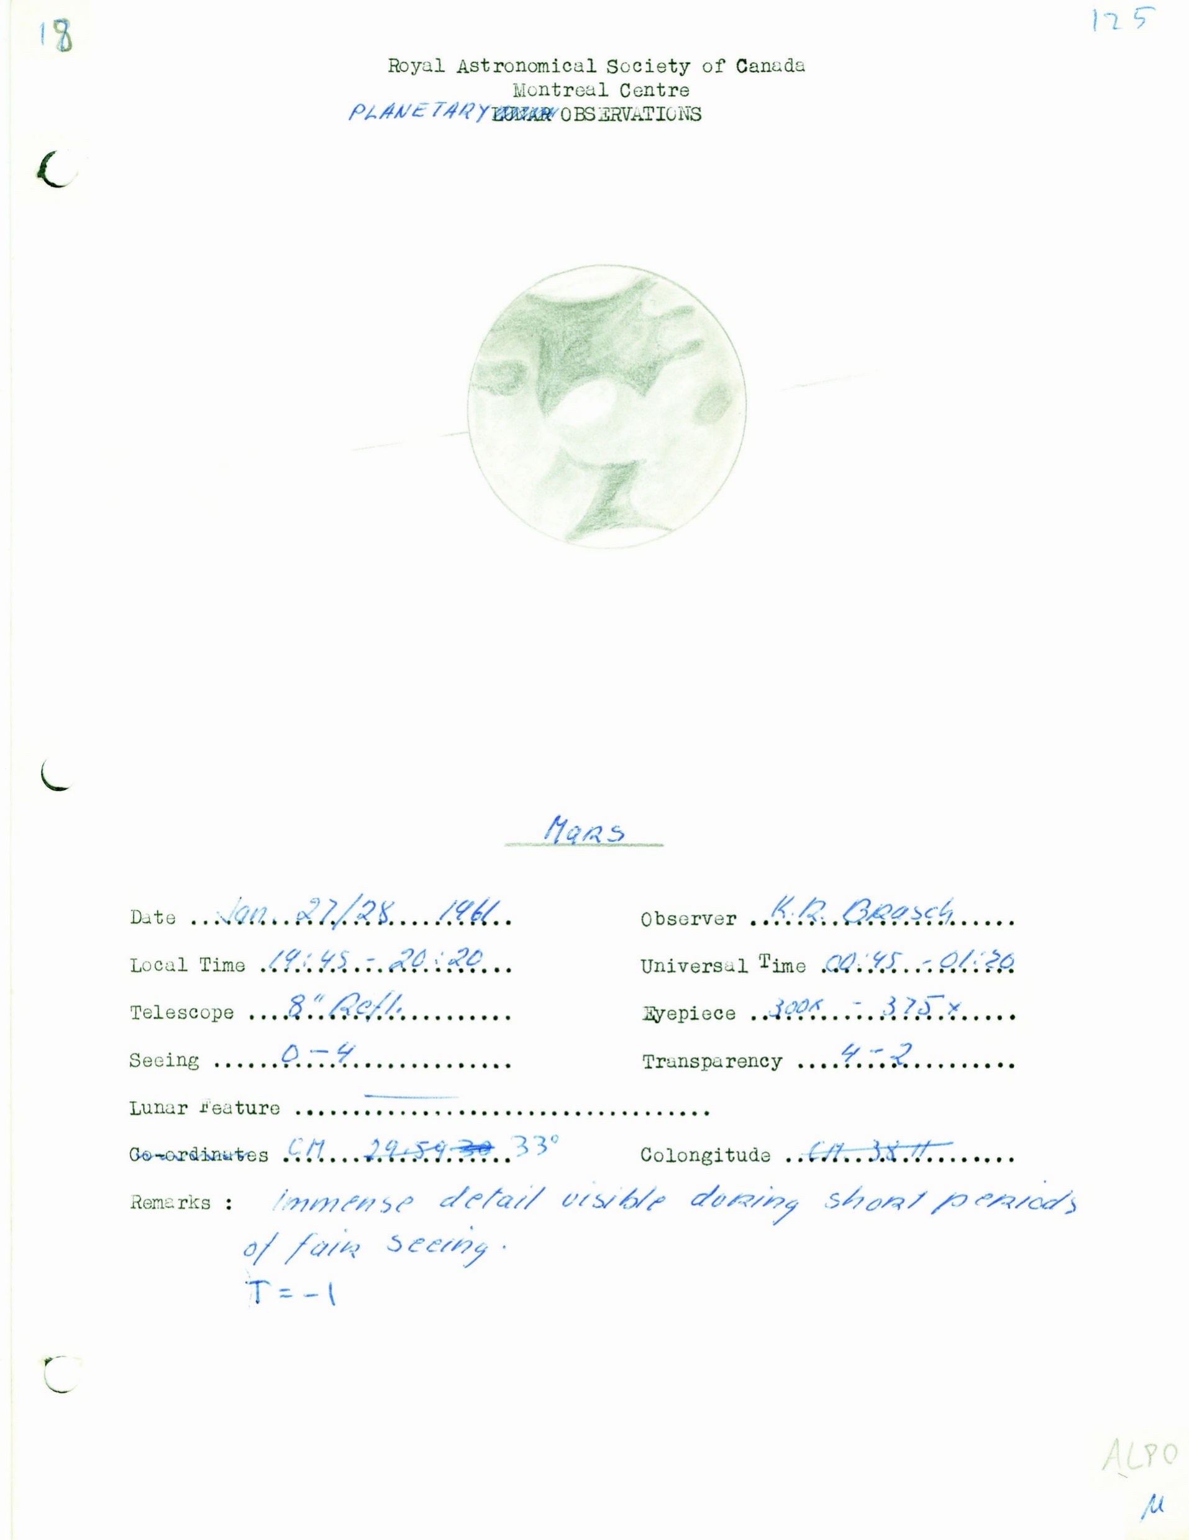
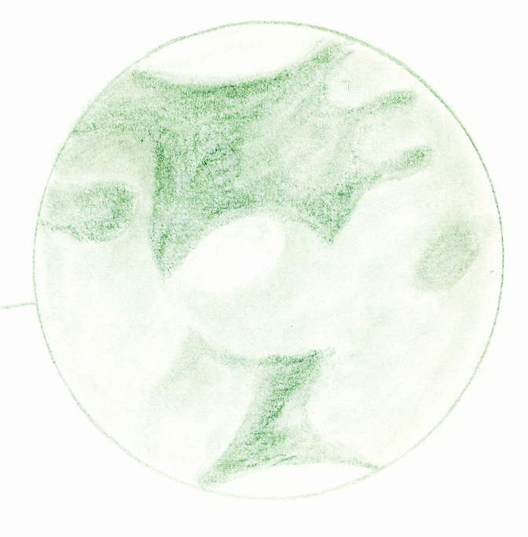
1960(-1961)

Slide 16
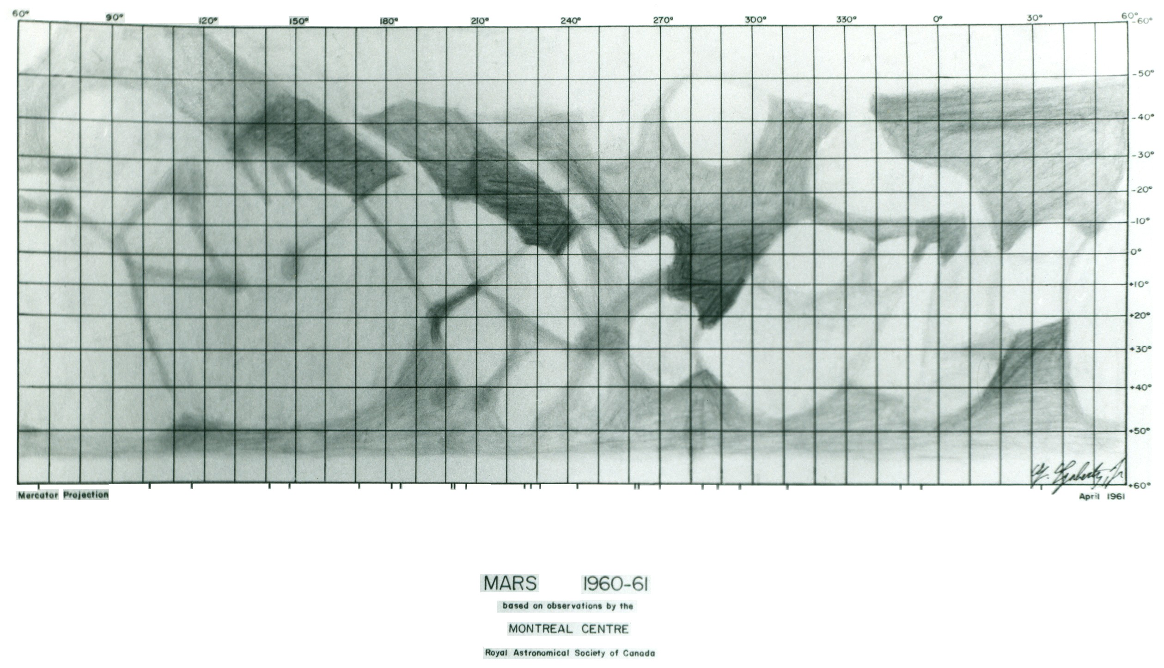
1960(-1961)

Slide 17
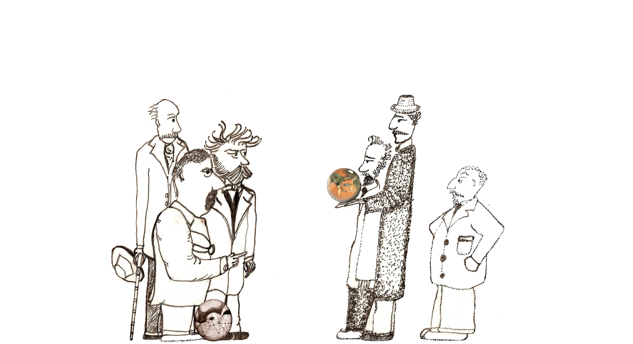
Percival Lowell
E.M. Antoniadi
Camille Flammarion
Walter Maunder
Giovanni Schiaparelli

